Slide 1

Jul / 2024
We are Qintess
Accelerating Digital Transformation for Businesses
Accelerate your essence

Slide 2
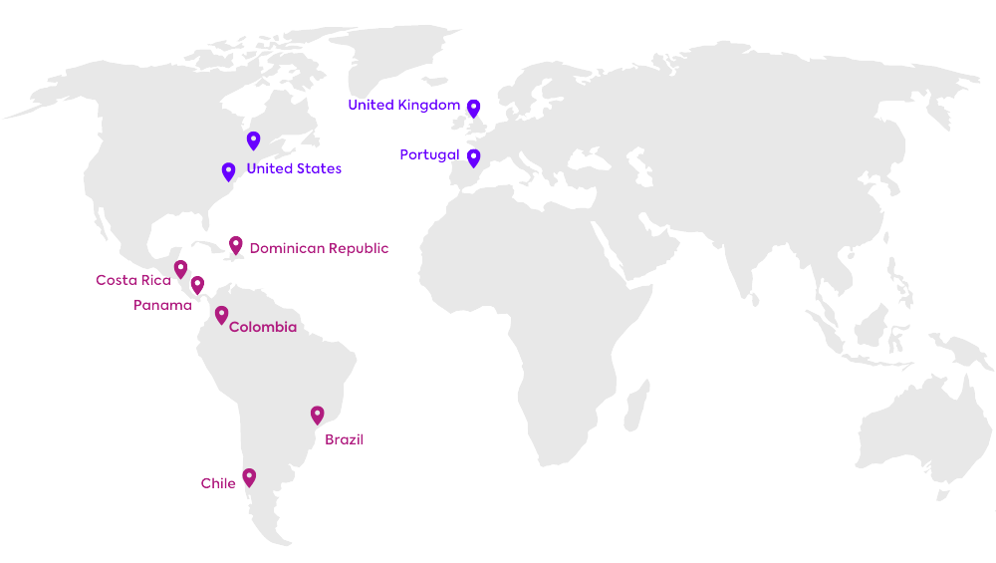





We are Qintess
Global technology company with roots in Brazil.
Diversity and Inclusion
Sustainable Capitalism
Experience Management
Agile Automation
Decision Science & AI
Open Innovation
FOLLOWING THE INNOVATION CURVE
ESG
Global Delivery Centers
Local Client Intimacy Team
DIFFERENTIATED TEAM
Growth Mindset
DNA of Innovation
Agile Work Way
Top 100
Most innovative companies in Brazil
by IT Mídia & PwC
EXPERIENCE IN VERTICALS
ACCESS TO THE WORLD
3.000+
National and international talents
Top #3 in Financial Services
Top #3 in the Public Sector
Top #5 in the Retail Sector
Top #5 in the Utilities Sector
Global Entrepreneur Network
Global Investment Funds
Worldwide Academic Institutions
NYU STERN, UNC, MACKENZIE
World Class Research
800+
Customers in 9 countries on 14 sites
2

Slide 3








High-value offers that deliver tangible results
InfraestructuraDigital Infrastructure and Cloud Architecture
Design, implementation and support of modern digital infrastructures.
Acting in on-premise and cloud environments, with a focus on robustness, security and scalability.
Creation of secure, scalable and high-performance computing environments.
Support efficiency and innovation in business operations.
Análisis de Datos, Ciencia de Decisiones e Inteligencia Artificial
We transform data into strategic decisions with AI and data science.
We accelerate decision models for quick and assertive choices.
We generate insights to optimize processes and strategies.
We offer a broader vision with Big Data and Business intelligence.
DIGITAL INFRASTRUCTURE
AI & DECISION SCIENCE
Strategic consulting and Advisory
Customized strategic solutions for business environments in constant change
Support in transforming and overcoming operational and strategic challenges.
We act as an extension of leadership with an independent vision.
Use of data, operational rigor and focus on long-term value.
Software development, Modernization and Industrialization
We accelerate digital transformation with agile development and systems modernization.
We use low-code and intelligent automation to optimize processes
We allow rapid execution and scale of strategic decisions.
Focus on operational excellence with tailor-made solutions.
STRATEGIC CONSULTANCY AND ADVICE
APPLICATION DEVELOPMENT
Process excellence and Operational Efficiency
We automate and optimize processes for greater operational efficiency.
We use BPM, RPA and low-code to accelerate innovation and reduce errors.
Focus on agility, cost reduction and increased productivity.
SAP Solutions and technological Capacity
Strategic support in the selection and implementation of personalized SAP solutions.
Experience in on-premise and cloud environments.
We guarantee optimized, scalable and future-proof operations.
We act to simplify processes, improve decision making and continue integration into the organization.
SAP SOLUTIONS AND TECHNOLOGICAL CAPACITY
PROCESS EXCELLENCE

Slide 4
INDUSTRIALIZATION OF SOFTWARE DEVELOPMENT

Slide 5
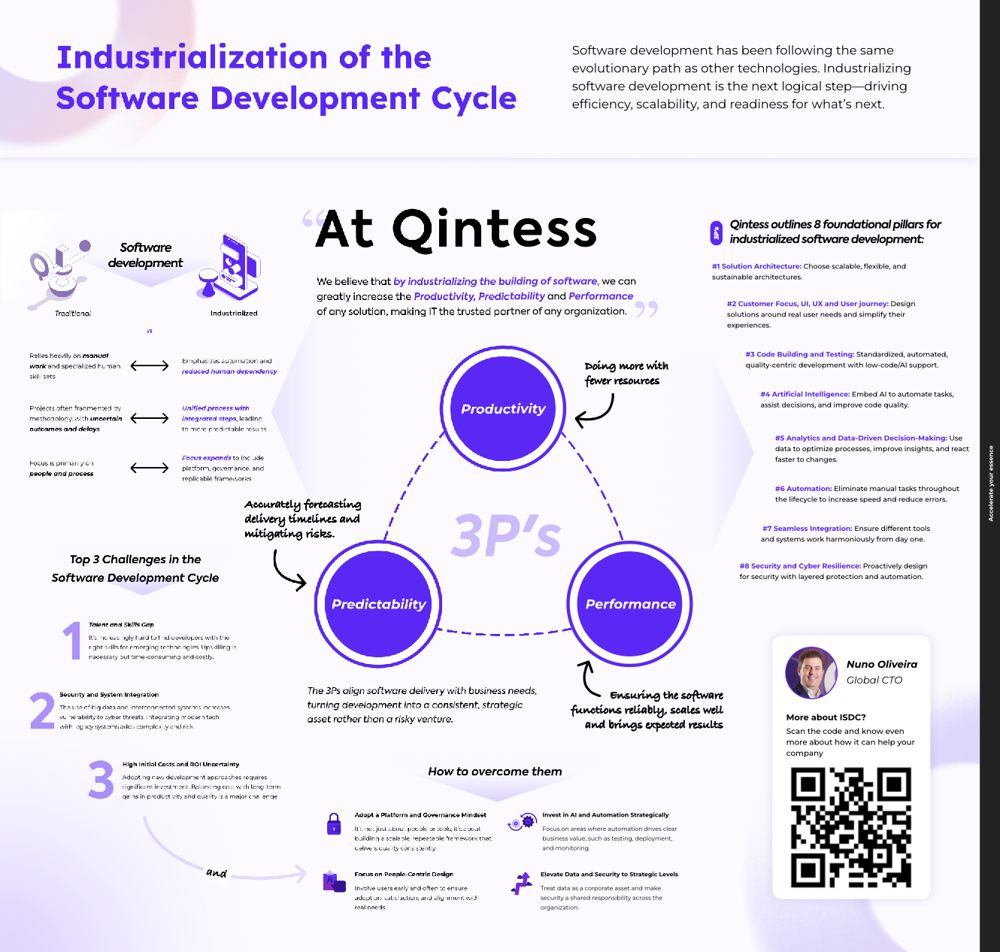

Slide 6
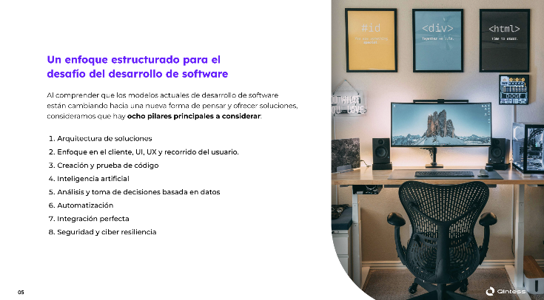
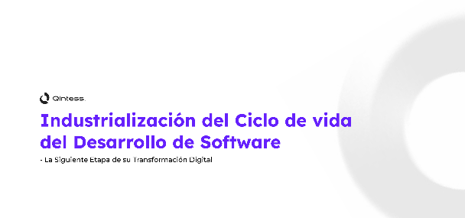
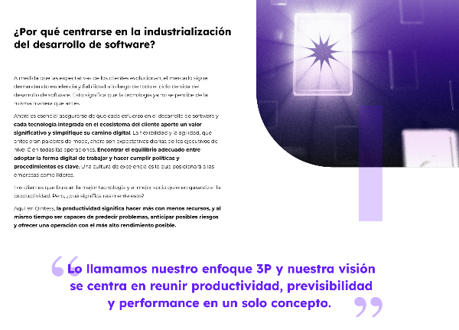
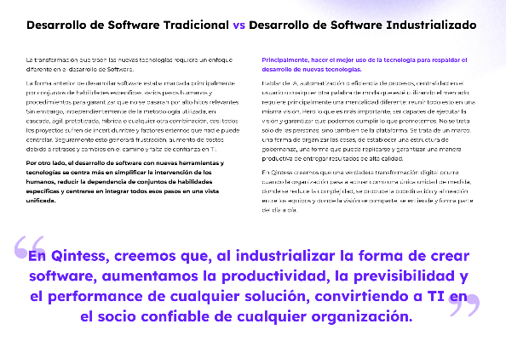
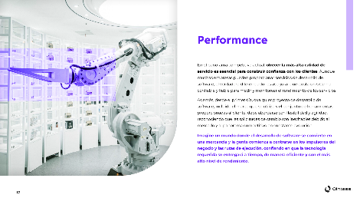
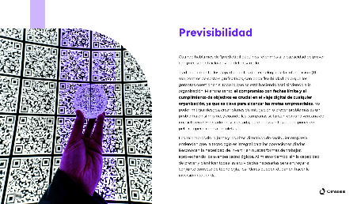
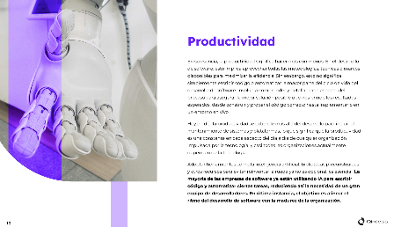

Slide 7





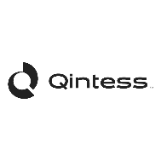
May not be fast enough to meet the speed of business change
Addresses the existing shortage of development professionals in the market and the turnover in the technology area
The challenges in traditional software development
It can make the customer experience difficult due to the natural complexity of the development process
May delay value delivery especially for App improvement and maintenance processes

Slide 8


The organizations have invested a lot in Agility, mainly resulting from Digital Transformation initiatives, but they have not achieved the expected results.
Accelerate “Time to Market”
Improve Quality
Boost Process automation
Improve the customer experience
Enable innovation capacity
Increase competitiveness
Achieve more Revenue
Reduce costs
accelerate your essence
Notes:
Porque não deu certo....
Destacar os pontos relevantes das dores
Adesão das outras áreas
A empresa não entender que é um projeto da organização e associar a iniciativa de TI
A agilidade ficou muito associada a projetos de TI e transformação digital
A TD ficou associada a foco em tecnologia e não nas demais dimensões de transformação (pessoas, cultura)
Quais as ações corporativas devem ser realizadas para que a Agilidade seja suportada por diversas ferramentas “transformadas” para suportar a verdadeira transformação
Oferecer aonde está o problema e como poderá ser endereçado

Slide 9

Be AGILE
Hard
Mindset
Requires greater commitment from the Board
Skill in organizational ambidexterity
Executive support and c-level engagement
Organizational culture
Being Agile Way
Values
Principles
Adoption Effort
Practices and techniques
Are they just team practices?
Scaled methods
Local, departmental results
Market tools
Membership and engagement
Doing Agile Way
Tools and Process
Easy

Slide 10
BUSINESS AGILITY
to the ability of an organization to rapidly adapt and respond to changes in the market, customer demands, and emerging opportunities by embracing flexible practices, iterative processes, and cross-functional collaboration.
Predictable Delivery
Execution Agility
Adaptative Strategy
Business Agility
Value-Oriented Decision
Portfolio Agility
Deliver value faster across teams
Optimize decision to maximize business value
Evolve, create and respond to changes

Slide 11
AGILE TRANSFORMATION JOURNEY
Start from Where you are
ATRIBUTTES
CAPABILITIES
Corporate visibility and transparency
Strategic alignment of business objectives and value streams
Investments aligned with business objectives
Organizational flexibility reacting to changes
Corporate Technological Platform throughout the organization
Monitoring strategic objectives and results
OKR-based investment monitoring
Monitoring strategic investments and prioritization
CORPORATE AGILITY
Product Mindset with Portfolio Management
Balanced delivery with customer focus and strategy
Intelligence in customer response
Visibility from strategy to user story
OKR-based initiative monitoring
Continuous prioritization
Capacity Planning and Estimation, and Value Engineering
Strategic planning and Roadmap construction initiative
AGILITY IN INVESTMENTS
INTEGRATED AGILITY
TEAMS
Focus on DevOps – CI/CD
Coordinated planning with a regular cadence
Continuous dependency management across releases
Culture of Experimentation
Product and Design Management
Continuous integration and feedback culture
Cross-product dependency management
Objective, value-based prioritization of functionality
TEAM AGILITY
Delivery-based metrics
Local optimization with agile practices
Learning culture focused on predictability
Fun and predictable, high-velocity delivery teams
Automated speed measurements
Federated development infrastructure
Automated building, publishing, and monitoring
Platforms with high levels of reuse, guidelines and productivity

Slide 12



Organizations have found different ways to improve operational efficiency.
Understanding your ability to execute
Discovering the right course of action
Act in real time to ensure execution and improve results
Digital Process Automation (DPA)​
Low-Code Applications (LCA)​
Business Intelligence (BI)​
Business Process Management (BPM)​
Process Mining (PM)
Qintess Offer​

Slide 13
Not all processes can be easily automated.
Some of them require rethinking and a better understanding of how to achieve their desired value.
accelerate your essence

Slide 14






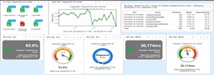
What is Bring to?
A Qintess proprietary platform supporting the vision of task automation, where a robot/script is configured to handle existing applications in the same way that a person would, through the application's user interface, to perform a certain task.
Systems A
Bring to
(Cloud or on-premises)
Client Page
Agent
SAP
Mainframe
Intranet
Web page
...
Client
Virtual machine
(anywhere)
Consoles
Agent
Systems B
Are you able to change your systems or do want to leverage the skills and know-how on the way people work?

Slide 15

Focus on your business
Spend more time thinking about how to create value for your customer instead of developing an app
Qintess helps you overcome these challenges!
Increase ROI and reduce time
You can go from an average of 6 months to 4 weeks, launching products faster and gaining users first
Simplify testing, piloting and modifications
You can more easily align with customer needs and implement changes faster
Bringing your expertise to help accelerate your digital transformation and software development through OUTSYSTEM Low Code Platform
Democratize your knowledge
Everyone can participate and work with the tool.
Innovate in one click
You can connect any new asset, with 6,000+ available assets, 715+ resources, AI integration and impact analysis

Slide 16

REASON The AI you can Trust
POWERED BY

Slide 17


In Gartner research, published in July 2024, it highlights the challenges in decision-making and the opportunity that organizations perceive in AI-assisted decisioning
Decision Intelligence is an evolving discipline that combines data, analytics, AI, automation, and human knowledge and expertise to help make better decisions
Over the past 2 years, business decisions have often been more complex, with many stakeholders and diverse scenarios The large daily volume of strategic decisions and moves the "needle" of the business American research shows that large-scale errors are occurring, representing large financial losses due to poor decision-making Research shows that 75% of Global 500 companies will apply decision intelligence by 2026
accelerate your essence

Slide 18
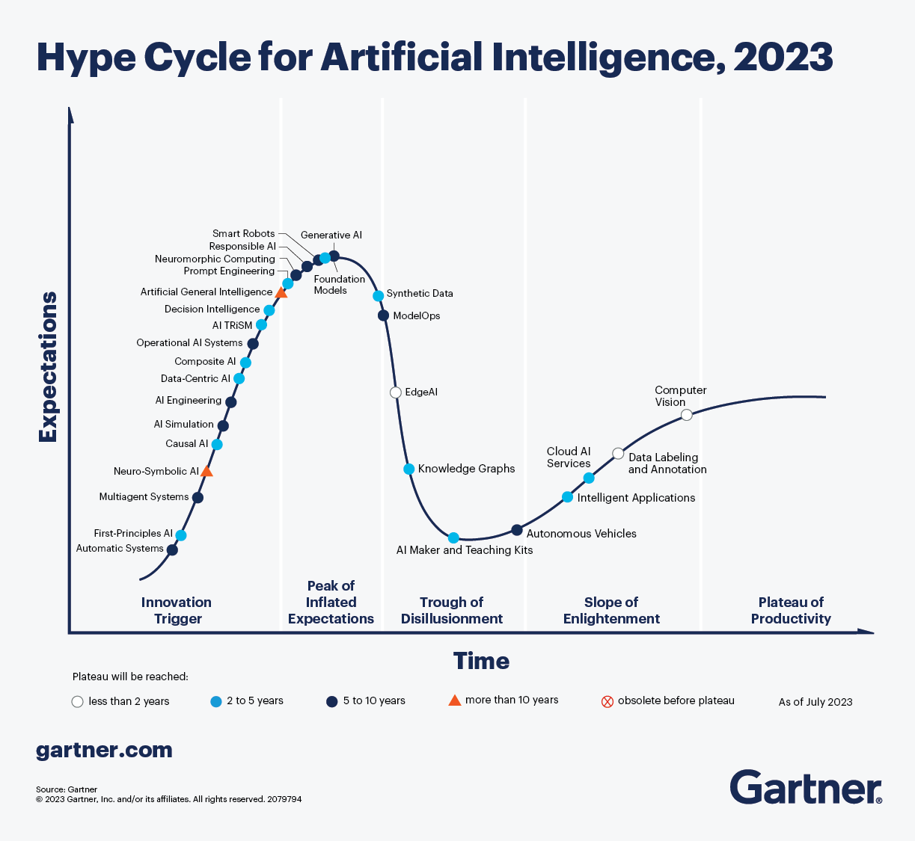
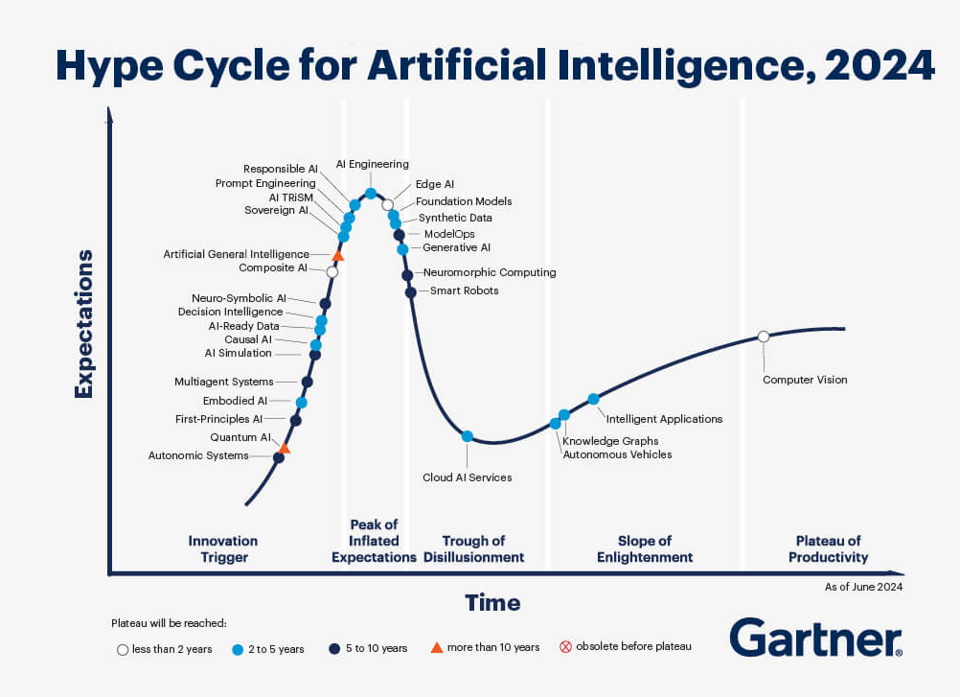
GARTNER hype cycle artificial intelligence

Slide 19
Potential challenges may arise during implementation, transforming your AI trajectory into a complex and challenging endeavor
Poor decisions cost money
Lack of trust in AI
Capability shortfalls
All organizations employ teams that make poor operational decisions.
The result is high costs, compliance failures, poor customer outcomes and lost revenues.
This has led organizations to invest in AI decision-intensive processes.
Machine Learning (including LLMs) suffers from the problem of unreliable data sources used to train it.
They make predictions, not decisions, and LLMs are prone to errors and the creation of illusions.
The underlying processes are a "black box", lacking transparency, explain ability and therefore trust.
Data-first ML approach used by digital natives for simple use cases (e.g. advertising) do not translate to higher complexity decisioning.
Linear technologies, like BPM and RPA, only handle low-value tasks and fail when applied to complex projects.
These technologies cannot be applied to decision-intensive processes.
Therefore, it is crucial not only to recognize the value of AI and express interest in its application for your business, but also to execute its implementation accurately

Slide 20


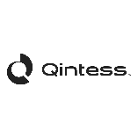
Human Digital Twin
Humans trust Humans and not machines. Some are afraid of losing their jobs and that makes it harder to share knowledge.
Organizations cannot be dependent on specific SMEs and must be able to scale.
Mapping the human decision-making process and creating the Human Digital Twin becomes a priority for the organization.
Qintess’s Vision
Knowledge and Decision First
Knowledge is represented as extended graphs based on formal documentation (eg policy, regulations), expert knowledge or both - with no training data required. Focus on a symbolic Reasoning Engine over these graphs — with their data connections — to make high quality evidence-based decisions. Graphs are human-readable and easy to understand and test.
Decision outcomes are explainable, reliable, traceable.
Graphs can include nonlinear business rules with weights and certainty set by experts or informed by data. Multiple knowledge graphs can be connected to each other and to numerous data sources.
We strongly believe in the need to build trust on AI by creating the Human Digital Twin concept
Trust Decisions made with existent Data (or find the gap on it)
Empower the SMEs to build trust on the Human Digital Twin
Use trustworthy data to test the models and identify data quality gaps
Fix data trust issues and refine the model
accelerate your essence

Slide 21

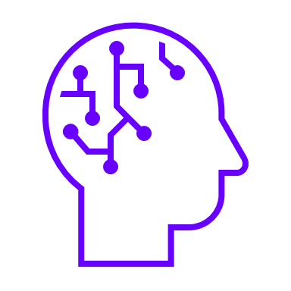
AI adoption journey in decision making From prediction to reasoning: the need for trust
Amplifies parameters and interaction for reliable and traceable decisions, with deterministic results
Reason “Marketplace”
Combine Specific Data, Expertise, and AI for Decision-Making
Scale your AI with Reason
Simplify and Scale complex decisions Discover and expand to new Areas Explainable and Auditable Decisions
Fraud
Price Optimization
Governance
Strategic Business Decisions
Tax Assessment
Financial Planning & Compliance
Risk Assessment
Insurance
Identification & Compliance
Resource Management and Planning
Sales
Healthcare & Compliance
… and much more!
There is no specific problem-solving focus, with open-ended questions based on probabilistic dialogue
Retrieval Augmented Reasoning (RAR)
Retrieval Augmented Generation (RAG)
Combining your knowledge and data, with an engine that can understand and provide reliable recommendations
Knowledge-based reasoning and interacts to gather context
A complete chain of auditable evidence to ensure explainability, transparency, and reliability
High Confidence
Reliability and Transparency in Decision-Making
LLM Only (GPT)
Increases predictions with its data, but still lacks logical reasoning
Improves trust by using your own data, but still lacks transparency
Identify sources
Moderate explanation
Improved Confidence
Uses LLMs to predict words, without context or reasoning
Potential hallucination
Generic sources
No logical explanation
Low confidence for decision-making
14
VALUE
Human
Digital Twin
MATURITY
As you add more resources, confidence in the decision increases

Slide 22
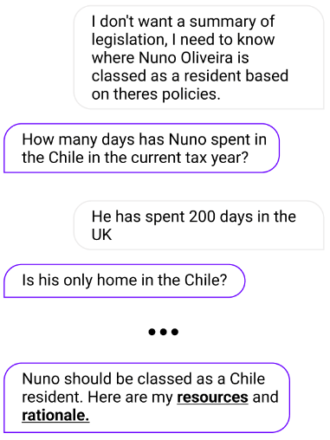
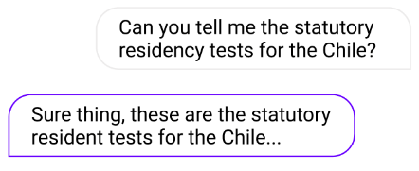
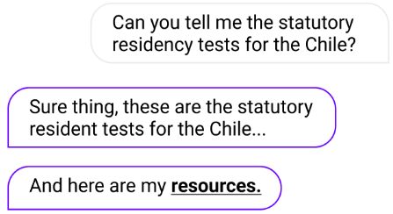
Applying Reason from prediction to reasoning: How it works
RAR solves problems that require context and delivers answers you can trust
LLMs make word predictions that cannot easily be trusted
RAG make word predictions over your documents and data
Retrieval Augmented Reasoning (RAR)
LLM only (GPT)
Retrieval Augmented Generation (RAG)
- Low trust
- High risk of hallucination
- No understanding of knowledge used
- No logical explanation
- Improved trust
- Answer leverages ‘your’ documents and data
- Signposts sources
- No logical explanation
- High trust
- Interacts to gather context
- Evaluates and reasons in context
- Signposts sources and provides a logical explanation

Slide 23

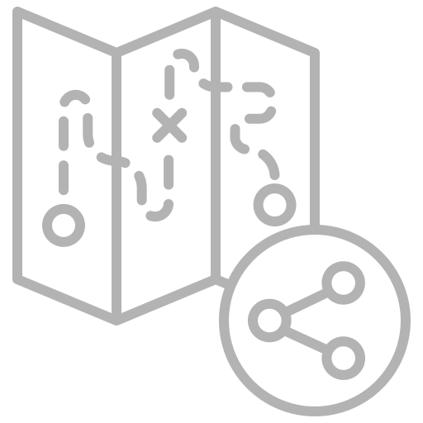

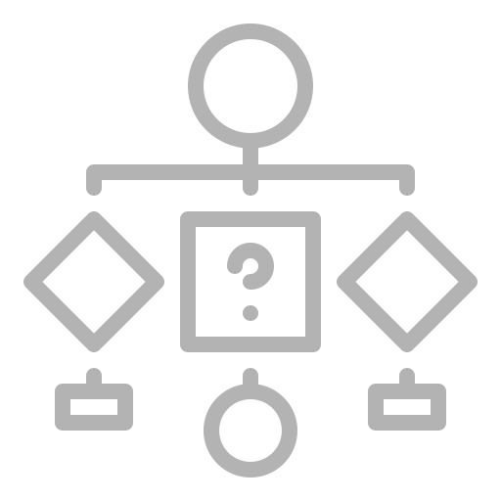






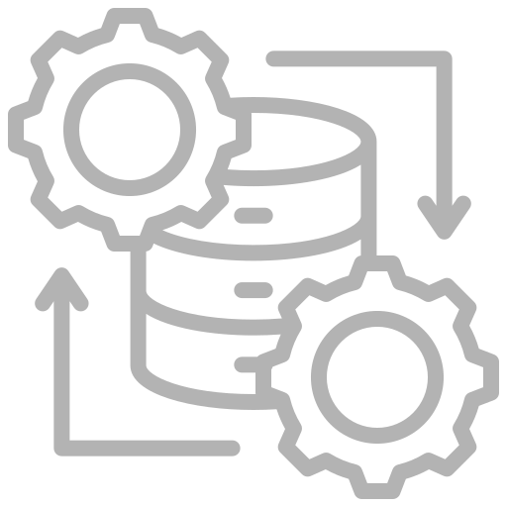
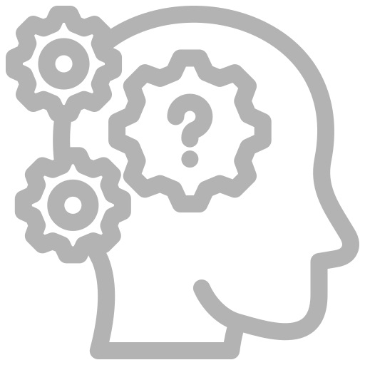

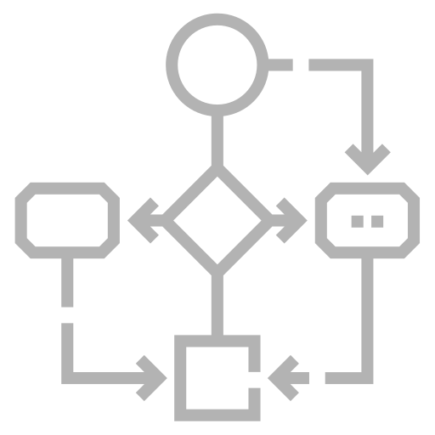
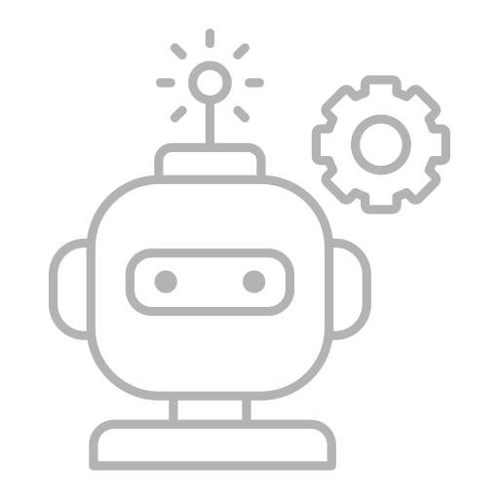

REASON Workflow
Delivering integrated solutions based on an Intelligent Decision-Making Platform
From "Mapping" to "Decision" to "Answer"
Knowledge Graph Repository
Human Digital Twin
Front-End
Decision Mapping
Low-Code Map Building
Knowledge map
Integration
Data Sources
Decision Intelligence Platform
Generative AI
Workflows
ETL/API Ops
Workflows
Reasoning
Evidence Tree
AI Agent
AIOps
Qintess Activities
Associate Tools
Reuse activity
Shared Ressponsability

Slide 24
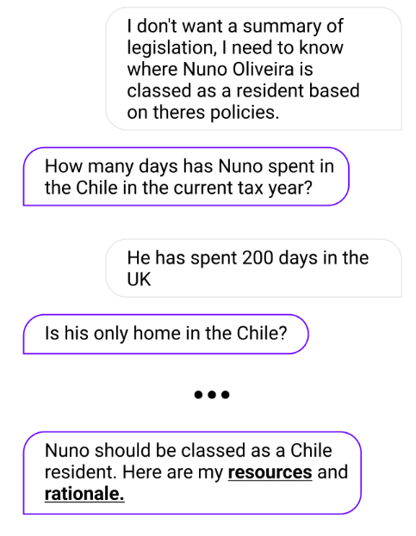
Deliver trusted outcomes with sources and logical reasoning
Move beyond search and summarization to contextual and evidenced decision intelligence
Retrieval Augmented Reasoning (RAR)
Solve contextual problems through iterative retrieval, consultation and enhanced logical reasoning.
Can answer complex situational questions and provide nuanced answers
Does not hallucinate
Produce links to sources but also a logical chain of reasoning as evidence
Iteratively consults with sources and users to gain context
Constrained to the scope of the knowledge graph
Incorporate your own expertise

Slide 25
Use cases
Finance and Taxation
Legal, Risk & Compliance
Operations, Sales and Marketing
Tax validation
Financial benefits
P&D / Innovation tax benefits
Intra/inter-company taxes
Validations of tax sources
Transactional Tax of Private Funds Report (PFR)
Corporate taxes
Property VAT management
Apuração de imposto retido en fonte
Transfer Price Management
International Expansion Planning
Conflict of Interest Assessment
Legal Representative Authorization Management
Data Permission Navigation
Project Risk and Governance
Risk Consulting Assessment
Money Laundering Risk Assessment
AML Transaction Monitoring
KYC (Know Your Customer) for Cryptocurrency
KYC Onboarding
Vacancy/Candidate Matching
Capacity Planning
Suggested Investment Approach (SIA) Appropriateness
Sales Scoring Tool
Claims Screening for Recovery (Insurance)
Fraud Identification
Mortgage Underwriting
Workplace Risk Assessment
Lateral Flow Testing Assessment
Prior Authorization (US Healthcare)

Slide 26

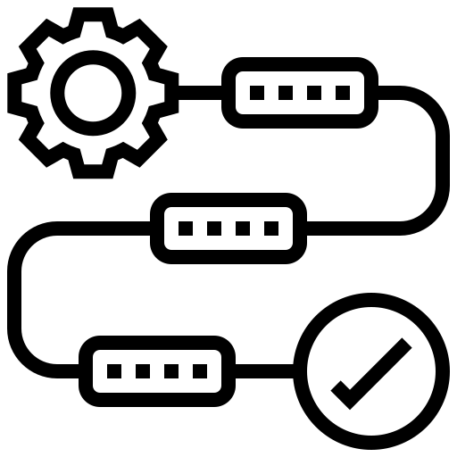






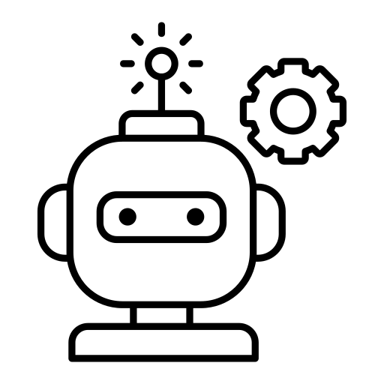

How does it work
Our experts can use existing documentation to generate the fundamentals of knowledge graphs (human experience)
Learn and Adapt from real decisions being taken every day. Human experts decide what should be used to enhance the decision process
Documentation
Path
Build
1
Learn / Adapt
6
The graphs are refined using information from SME’s (Subject Matter Experts) and optionally with scenario data. Human experts decide what should be adopted
Interaction Data
Refine
Reasoning Engine
Neural Engine
2
Interact through multiple channels including chat or API’s. The ability to explain is included in every decision
Interact
5
Language Engine
Business / Decision Expert
Training Data
3
Test
4
Testing tools allow experts to validate models for errors and bias. Solution produces a complete chain of reasoning (Evidence Tree)
Implement
Chat
ERP
Robots
AI Agents
Secure and smooth deployment, monitoring capabilities, and maintenance of models in live environments
Business / Decision Expert
Training Data
Model Ops

Slide 27
Do you still see any Reason to not choose Qintess as your Partner? Take the right Decision!
- Explainable
- Reliable
- Traceable

Slide 28
ADVISORY SERVICES BDA – Business Driven Architecture

Slide 29
Business Driven Architecture PORTFOLIO
1
2
3
4
5
IT
AS A BUSINESS PARTNER
IMPROVE
IT
EFFECTIVENESS
TECHNOLOGY AS A COMPETITIVE ADVANTAGE
ARCHITECTURE ADVISORY SERVICES
PROTECT ORGANIZATION
ASSETS
Align IT with Business to become a proactive Partner
Ensure maximum Opex, Pex and Capex efficiency and Service Levels
Leveraging market trends and solutions
Recommend architecture paths, DO’s and DON’Ts based on executive experiences
Focus on Security Strategy and major impacting initiatives
GOALS
IT business-driven Strategy
Business Architecture
Business Operating Model definition
Architecture Governance
Delivery Optimization - Self-Service tools and procedures, TCO reduction, etc.
Transformational Roadmaps
Architecture Reference models
Digital Business Architecture
Architecture recommendations, best practices and recommended paths regarding strategy, products or roadmaps
Support or drive Cyber Security Strategy definition
Define and drive Security strategic programs
SERVICES
Qintess also promotes and drives all change management activities, bridging the gap between Business and Technology

Slide 30
A structured approach to ensure IT meets Business and vice-versa
Organization Needs
Architecture Vision
Business Architecture
Information Systems Architecture
Technology Architecture
Opportunities & Solutions
Migration Planning
Governance
Architecture Change Management
Provides a holistic approach to addressing these challenges by establishing a structured framework for aligning IT capabilities with business goals.
Enables organizations to analyze, design, and optimize their IT systems, processes, and technologies to support current and future business needs.
By defining standardized architectures and governance mechanisms, promotes consistency, interoperability, and scalability across the enterprise.
Ultimately, empowers organizations to make informed decisions, streamline operations, and drive innovation while reducing costs and mitigating risks.

Slide 31
Vision, Mission and Value
Architecture encompasses more than just Technology, Software or Systems Architecture.
- Qintess understands Architecture as the tool that provides a global and coherent view across Business, Information, Systems and Technology; not only to design IT systems, but to enable business changes supported and facilitated by IT. Therefore, Architecture is a lever to help transform an organization.
- Covers the structure and relationships of the enterprise, its business models, how the organization should work, and how and in what way the organization will be supported, via IT, in achieving its business objectives. The Architecture model is divided into several viewpoints. Combining them, each “cell” in this model has a set of defined Artifacts. These are views that allow architects to gather and visualize artifacts to assist in modeling and communicating the Architecture with various stakeholders.
Governance
Security
Business
Data
Information Systems
Technology
Why?
Context
Vision, Goals, Motivation
What?
Conceptual
What do we want? Taxonomy and organizational alignment
How?
Logical
Solutions, Roadmaps and Benefits
With What?
Physical
Toolset, Procedures and Change Management

Slide 32
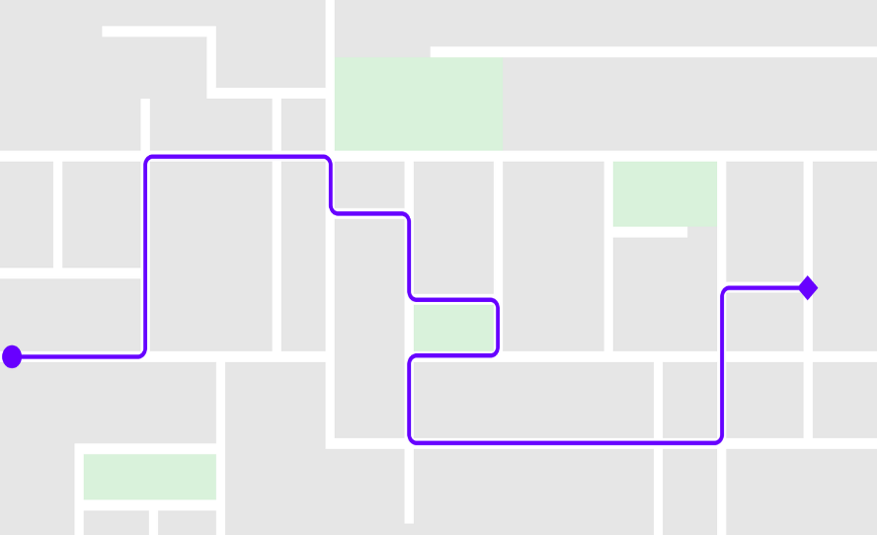






Qintess will help you choose the best path to success…​
Subtitle
Infrastructure
Process Awareness
Culture strategy
Alerts
To Be
Achievements
Business opportunity
Business strategy
Alternative paths
Technology
Security
Shortest path
Technology availability
IT strategy
The best path
Data
“The most impactful journeys don't follow a straight line… they carve their own path, weaving through challenges to reach extraordinary destinations."
Nuno Oliveira, Qintess VP & Global CTO​
ARCHITECTURE PATH

Slide 33
…supported by an effective Architecture function
Communications
Governance & Change Management
Architecture Methodology
Architecture Content (To-Be)
Establish and implement a strategy for communicating the value of Architecture to all stakeholders and gaining their sponsorship and involvement in Architecture activities within business and IT initiatives.
Define and implement a governance model and change processes to ensure the validity and completeness of the architecture at all levels, including the set up and operation of a “Architecture Board” to drive convergence towards the Architecture.
Define a framework and methodology for architecture development, setting out the approach, techniques and content requirements for all aspects of the Architecture - business, information, information systems and infrastructure, including security alignment.
Contribute to successive releases of the Architecture based on development of architecture content in functional domains. Content will evolve towards a complete Enterprise Architecture through engagements.
Architecture Content (As-Is)
Architecture Capability
Architecture Tools
Contribute to successive releases of the Architecture based on documentation or working sessions of the current state (as-is) landscape. Content will evolve towards a complete Enterprise Architecture through aggregation of knowledge and information.
Define the skills and competencies required by the Architecture function and establish learning and development activities to help develop and sustain these within the organization.
Define requirements for supporting tools, establish a process for evaluation and selection, and implement chosen tools to support all architecture activities. All Architecture content will be migrated into the Architecture toolkit over time.
ARCHITECTURE FUNCTION

Slide 34
Managing the Architecture is an ongoing Process based on a dialogue with the business
Projects
Projects develop and deliver solutions which meet individual business and technical needs in the context of the Future architecture
Apply to
Change
During the process, the architecture footprint is updated based on results of the projects.
The architecture lifecycle in an ongoing process that forms the core of architecture work, to meet the business and information technology needs.
The process is based on a dialogue and interaction with the business users to ensure business alignment.
Future Architecture
Current Architecture
Current Business &
IT Environment
The Current architecture represents the current state of the IT landscape (Application and Systems catalogue) ​
The Future architecture is based on Business and IT Strategies and scenarios​
Adapt & Prepare the Future
Learn
Requires Business Architecture domain mapping based on business capabilities and Application catalogue
Business and IT
Business & IT Strategy
Technology & Business Trends
Business / Technology Scenarios
ARCHITECTURE FUNCTION

Slide 35
ADVISORY SERVICES Digital Office & NextGen PMO

Slide 36

Digital Office Major challenges and objective
Organizations are investing in a business-driven transformation plan which covers Operational Processes, Data and Technology, always considering Cybersecurity.​
The success of the transformation is based on Client’s ability to: 1) find synergies between teams and areas; 2) ensure a Solution Architecture mid-term strategic mindset; 3) manage a challenging delivery plan, providing expert support as well as compliance to plan & budget.​
Qintess has extensive experience in leading the definition and implementation of strategic programs, that will mainly support operational efficiencies aligned with expected business growth.​
Objective
Partner to create a Digital Office and setup a Program to deliver the identified initiatives, providing both expert project advisory, solution governance support and project management capabilities that secure a successful business-driven delivery.

Slide 37
Digital Office guiding principles A business-driven technology team to support the transformation journey​ ​
Acts as the bridge between business and technology expressing technology in business terms and business in technology terms
Defines and maintains an investment framework within which business benefit return can be maximized on future technology investment​
Articulates business direction and priorities and focuses technology to support them​
Ensures a set of inter-working technologies that provides the platform for the business systems (applications) in the most efficient and effective manner in the delivery of the business goals​
Support business change and absorb and exploit technology change​
Refine, monitor and implement a governance process to support the delivery the defined roadmaps, ensuring an adaptive and business aligned Technology footprint​
The Digital Office is a central Governance Office that defines a framework to align and integrate business processes, information flows, applications, infrastructure and security, between areas and departments supporting organization goals and vision.​​​
Provides a consensus way that technology will be used to support the current and future business requirements​
Define and conduct processes to perform review, communication, compliance and enhancement to Architecture (Business and Technology)​

Slide 38



A layered approach to cover all workstreams​
Led by experts with business and technology mindset to ensure complete understanding of business needs as well as their feasible solutioning ​
Steering committee
Deliverables (examples):
Thought leadership​
Create governance structure ​
Secure strategic support​
Controlling & proposing countermeasures​
Cross Areas support and guidance
Alignment between different members in the same area​
Point of Views ​
Innovation applied Use Cases​
Cross functional areas alignment ​
Community Sharing - share and listen other customers with same challenges​
Market Trends​
Implementation Approach​
Organizational structure alignment​
Program level
Governance office
Advisory & Management
Manage, challenge and facilitate​
Project Management x Roadmap​
Business and functional expertise to facilitate, support, challenge and proactively drive results​
Solution/Architecture mindset
Deliverables (examples):
Business & technology roadmaps
Reference Business and Technical Architectures​
Project Governance (Project / program management) ​
RFI / RFP​
Solution Design (Options, Recommendations, E2E HL Solution Architecture, etc.)
Workstream level
Business areas
Tech team
Partners
Qintess services foster a business-decision-driven delivery, acting as SME and facilitators to meet the plan aligned with business expectations​

Slide 39

Digital Office structure Acting as an orchestrator between areas/teams, processes and solutions​ ​
Thought Leadership​
Change Management​
Senior advisors
Stakeholders
Governance
Program monitoring
Program manager
PMO
Initiatives Support (People, Processes, Solutions, etc.)​
Business + Tech Communities​
Processes
BOM: Business Operational Model
Architecture & Solution Design
Workstream 1
TBD *
Workstream delivery support
Workstream 2
TBD *
Workstream 3
TBD *
Workstream 4
TBD *
Specialized resources added to support each one of the Workstreams, keeping same senior team engaged in critical management roles

Slide 40
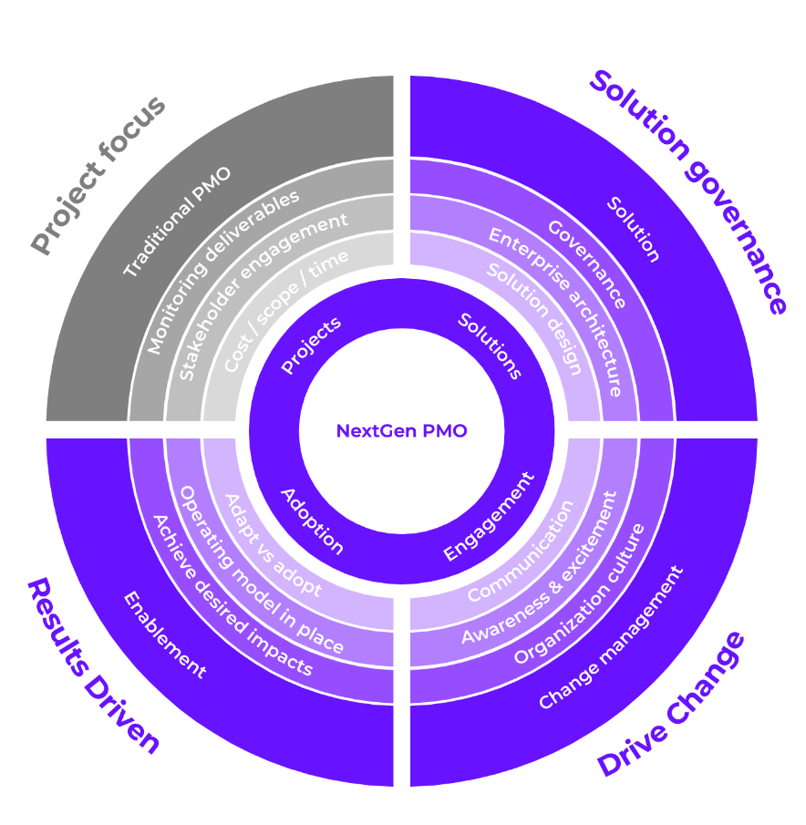
NextGen PMO A new approach of delivering greater results
Beyond the Traditional PMO, we believe that Solution Advisory and Governance, a clear Communication strategy and organization Enablement is the right way to deliver the expected results.
We drive and support our customers on their realization journeys achieving the expected outcomes

Slide 41
Core team structure and key roles
Provide executive-level guidance and oversight to ensure the successful alignment of digital transformation initiatives with overarching business objectives
ADVISOR
PROGRAM MANAGER
Responsible for overseeing the successful execution of organizational goals, ensuring that all initiatives are strategically aligned and well-coordinated
BUSINESS ARCHITECT
Acts as the bridge between strategy and execution, translating corporate vision into operational and technological roadmaps
SOLUTION ARCHITECT
Focuses on aligning IT strategy with business goals by assessing organizational requirements and identifying the most effective technology solutions
TECH SPECIALIST
Brings deep technical expertise and a holistic perspective to bridge the gap between business needs and technology solutions

Slide 42



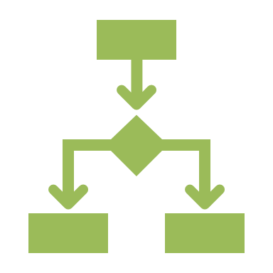


Key business benefits
Improved Strategic Alignment
Enhanced Agility
Ensures that all projects, initiatives, and technology investments are directly aligned with business objectives and long-term growth
strategies.
By adopting a flexible and adaptive governance model, organizations can respond more quickly to
evolving market trends, customer demands, and operational challenges.
Increased Innovation
Better Resource Utilization
A culture of CPI and technological advancement is fostered through the strategic integration of emerging technologies, data-driven decision-making, and process optimization.
Digital Office
Provide higher visibility and optimizing the allocation of human capital, technology infrastructure, and financial investments, eliminates inefficiencies and enhances productivity.
Improved Stakeholder Satisfaction
Measurable Business Outcomes
Through clear governance structures, transparent communication channels, and well-defined performance metrics, the framework ensures that stakeholder expectations are consistently met or exceeded.
The data-driven nature of the Digital Office and NextGen PMO ensures that all initiatives are tied to objectives and key results and measurable outcomes.

Slide 43




Key differentiators
Governance
Communication
Implements a robust governance structure that extends beyond traditional project timelines, ensuring long-term strategic alignment and operational efficiency
Prioritizes a clear and structured communication strategy to ensure seamless collaboration across all levels of the organization
Enhanced Communication and Stakeholder Alignment
Comprehensive Governance for Strategic Oversight
Digital Office
Continuous Innovation and Business Enablement
Business-Driven Technology Integration
Business-driven Technology
Innovation & Business Enablement
Serves as a strategic link between business and technology, ensuring seamless alignment between enterprise objectives and digital capabilities
Drives ongoing transformation by integrating emerging technologies and innovative strategies into business operations

Slide 44
Deliverables Main challenges in delivering expected results are on the human-side
GOVERNANCE STRUCTURE
 | Governance Framework
 | Governance Model Blueprint
 | Guiding Principles & Compliance Handbook
 | Governance Oversight Dashboard
 | Risk Management & Escalation Plan
STRATEGIC BUSINESS & TECHNOLOGY ROADMAPS
 | Enterprise Digital Transformation Roadmap
 | Technology Investment Strategy
 | Execution & Implementation Plan
 | OKR & Success Metrics Framework
CHANGE MANAGEMENT & STAKEHOLDER ENGAGEMENT
 | Change Management Strategy
 | Stakeholder Engagement & Communication Plan
 | Training & Upskilling Program
 | Performance & Adoption Tracking Dashboard
 | Resistance Management Framework
BUSINESS AND TECHNOLOGY ARCHITECTURES PLANS AND IMPACT ANALYSIS
 | Cross-Brand Technology Alignment Plan
 | Impact analysis on existing Roadmaps or Technology Adoption Strategy
We drive and support our customers on their realization journeys achieving the expected outcomes

Slide 45
ADVISORY SERVICES BDD – Business Driven Design

Slide 46





Business Driven Design Using design thinking principles and a human-centric approach to create new strategies and efficient business models
Outcomes
Human-centric
Understanding that the business environment is extremely competitive and dynamic, Qintess has developed an approach focused on creating new products, services and business models.
We combine our expertise in the world of business, innovation and design thinking to build a methodology focused on our clients, without losing sight of 3 main concepts:
Human-centricity
Viability
Feasibility
Viability
Feasibility
Integrative perspective
unified vision
Prototypes and Tests

Slide 47



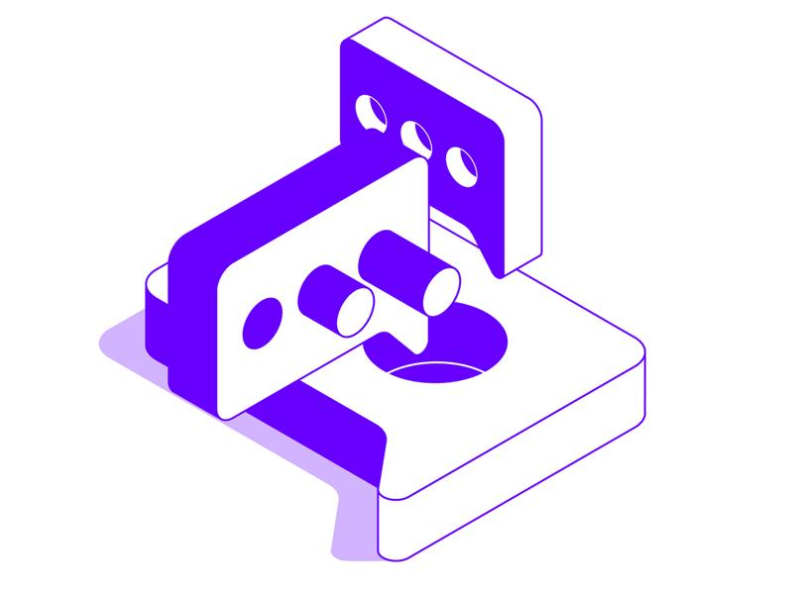
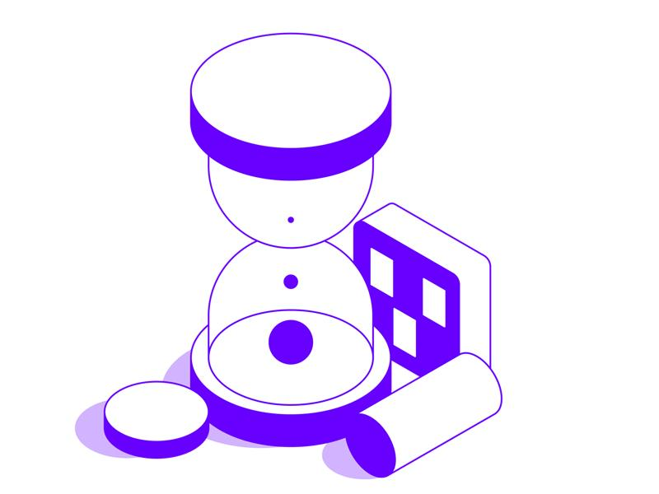

Why invest in Business Driven Design? Shaping a compelling brand and a solid business model, keeping your company human-focused and future-ready. Beyond Customer Impact, business design also drives internal efficiency and adaptability. It empowers teams to work collaboratively, break silos, and iterate quickly in response to change
Brand repositioning
We help you revitalize your brand by crafting an authentic and engaging identity that strengthens your connection with your audience and sets your business apart in the market.
Foster innovation
We work side by side with you to create an environment that fosters creativity, fuels experimentation, and transforms great ideas into innovative, competitive solutions.
Boost efficiency and productivity
Identify and eliminate bottlenecks in your processes, simplifying complexity and implementing improvements that make your team more agile and productive.
Deeper Customer Understanding
Leverage data and strategic insights to help you truly understand your audience, creating more personalized experiences that align with their needs.
Growth Strategy Support
Develop smart, sustainable strategies to help your company grow with strength—preserving your identity while scaling in a structured way.
Business Model Evaluation
We support you in validating and refining your business model, ensuring it is financially sustainable, competitive, and aligned with market demands.

Slide 48
How does Business Driven Design works? 4 dimensions where change must take place for organizations to develop an ecosystem that allows them to react quickly to human needs, delivering high-quality digital experiences at scale.
1
2
3
4
Immersion
Diagnosis
Co-creation
Final Report
INPUTS
Market research
Internal process study
Product study
Flow mapping
Pain points survey
Analysis of the collected material
Definition of personas
Creation of hypotheses
Solution Ideation
Proof of Concepts
Testing
Refinement
Final report
Action plan
Success metrics
OUTPUTS
Information and inputs for correct diagnosis
Understanding the contexts
Defined objectives
List of personas
Hypotheses of solutions for testing
Solutions Tested
Refinement
Presentation of all collected and constructed material
Action plan steps defined
Specific metrics for the project

Slide 49

DATA SECURE SENTINEL
POWERED BY
XQMSG.co

Slide 50
Data sovereignty & security – Why does it matter? Loss of Data Control is the Greatest Obstacle to Cyber Security and Sovereignty Compliance
Organizations Lack Awareness of Their Data and Access Permissions
Most organizations don’t know what data they have or who should be accessing it
Cost of non-compliance and penalties can be high and put at risk the future of any organization
No Control of Stolen or Shared Files
When data is stolen or shared there is no record or control over who, where, and when data is accessed, leaving the organization open to indefinite extortion, IP loss and fines.
$4.2M is an average total cost of a data breach in USA
Organizations Can Not Control Where Their Data is Accessed
Data shared or exfiltrated has to geo access control at the edge.
Many organizations reported breaches in the last 3 years
Governance & Compliance Complexity Slows Business
When data is moved or shared to a new environment, it loses its protective security measures and can’t be monitored.

Slide 51
Furthermore, there are several compelling reasons why companies must prioritize data protection
Legal and Regulatory Compliance
Reputation
and Trust
Financial Consequences
Intellectual Property Protection
Ransomware
Extortion
National
Security
Employee Data Protection
Cybercrime prevention
Data Breaches
Ethical
Considerations
accelerate your essence

Slide 52
Recurring business impacting challenges
Security Challenges
Tracking Compliance : Comply with recent chain of custody requirements
Secure on Prem & Cloud Storage: Data access control, Ransomware, Back-up Data, DEM
Secure Legacy Systems: Unsupported and older systems needing security
Block Unauthorized Traffic: Protect APIs, lateral movement
Data Intake, Share Externally
Business Challenges
KYC or Mobile Payments (Transactions)
Compliance and Visibility with PCI, GDPR – Dala Transparency and Localization – and other regulations
Secure Email
Third-Party, Ransomware & Data Breaches
Limited IT & Security Budgets
Vendor Lock-in
IT burden and compliance costs are overwhelming security teams

Slide 53
Date secure sentinel value offer Traditional Data Loss Prevention solutions are complex, hard to deploy, and require extensive data categorization and policy management
Value Offer
Scalable data security across environments
Efficient SecOps automation for logging and monitoring
Zero trust data access governance
Unified data loss prevention
Data detection and response
Trust & Compliance Visibility
Reduce Downtime & Disruptions
Minimize IT Workloads
Lower Compliance Costs
Save Time & Labor
Reduce Third-Party Risk Management Costs
Geofencing data access through local keybanks for jurisdictional control​
Know and Control your data
- Control Over The Location of Your Data
- Verifiable Control Over Data Access
- The Ability to Encrypt Everything Everywhere
- Data Resilience From The Edge To The Cloud
- Data sovereignty
- Compliance for regulated industry data
- Ransomware extortion protection & data exfiltration
- Increase efficiencies and unified visibility

Slide 54
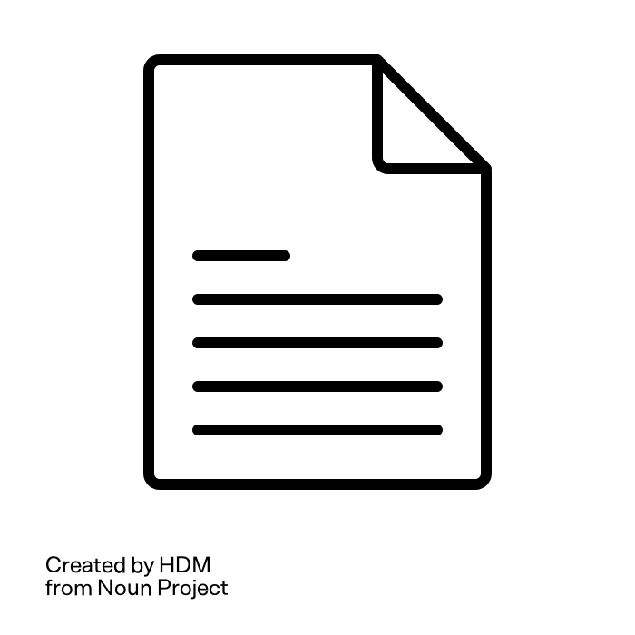

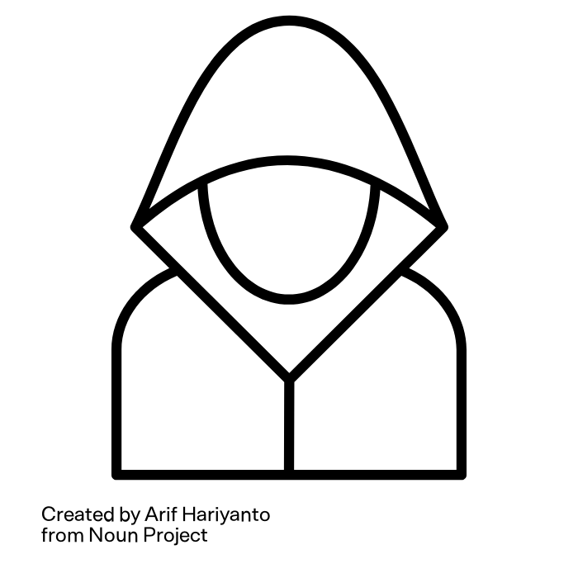
Why traditional cyber security fails
firewall
Perimeter-based security is obsolete
Ransomware can bypass firewalls and endpoint protections.
Stolen Data
Back Up
Misconfigured access controls
Network based policies are easily circumvented.
Data
Attacker
Legacy encryption is static
Once stolen, data remains accessible to attackers.
Data immutable backups are ineffective against extortion
Attackers steal data before encryption, forcing companies to pay even if they restore systems.

Slide 55






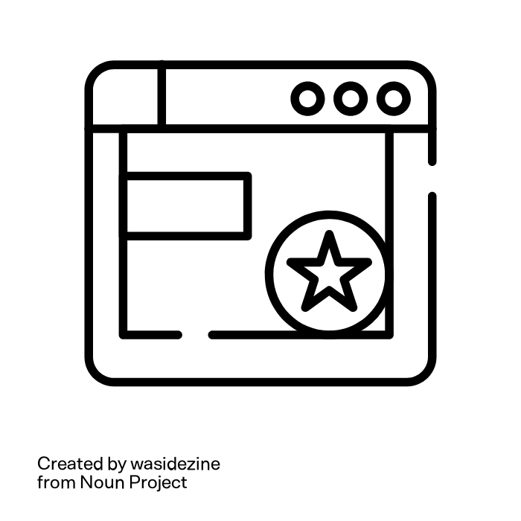

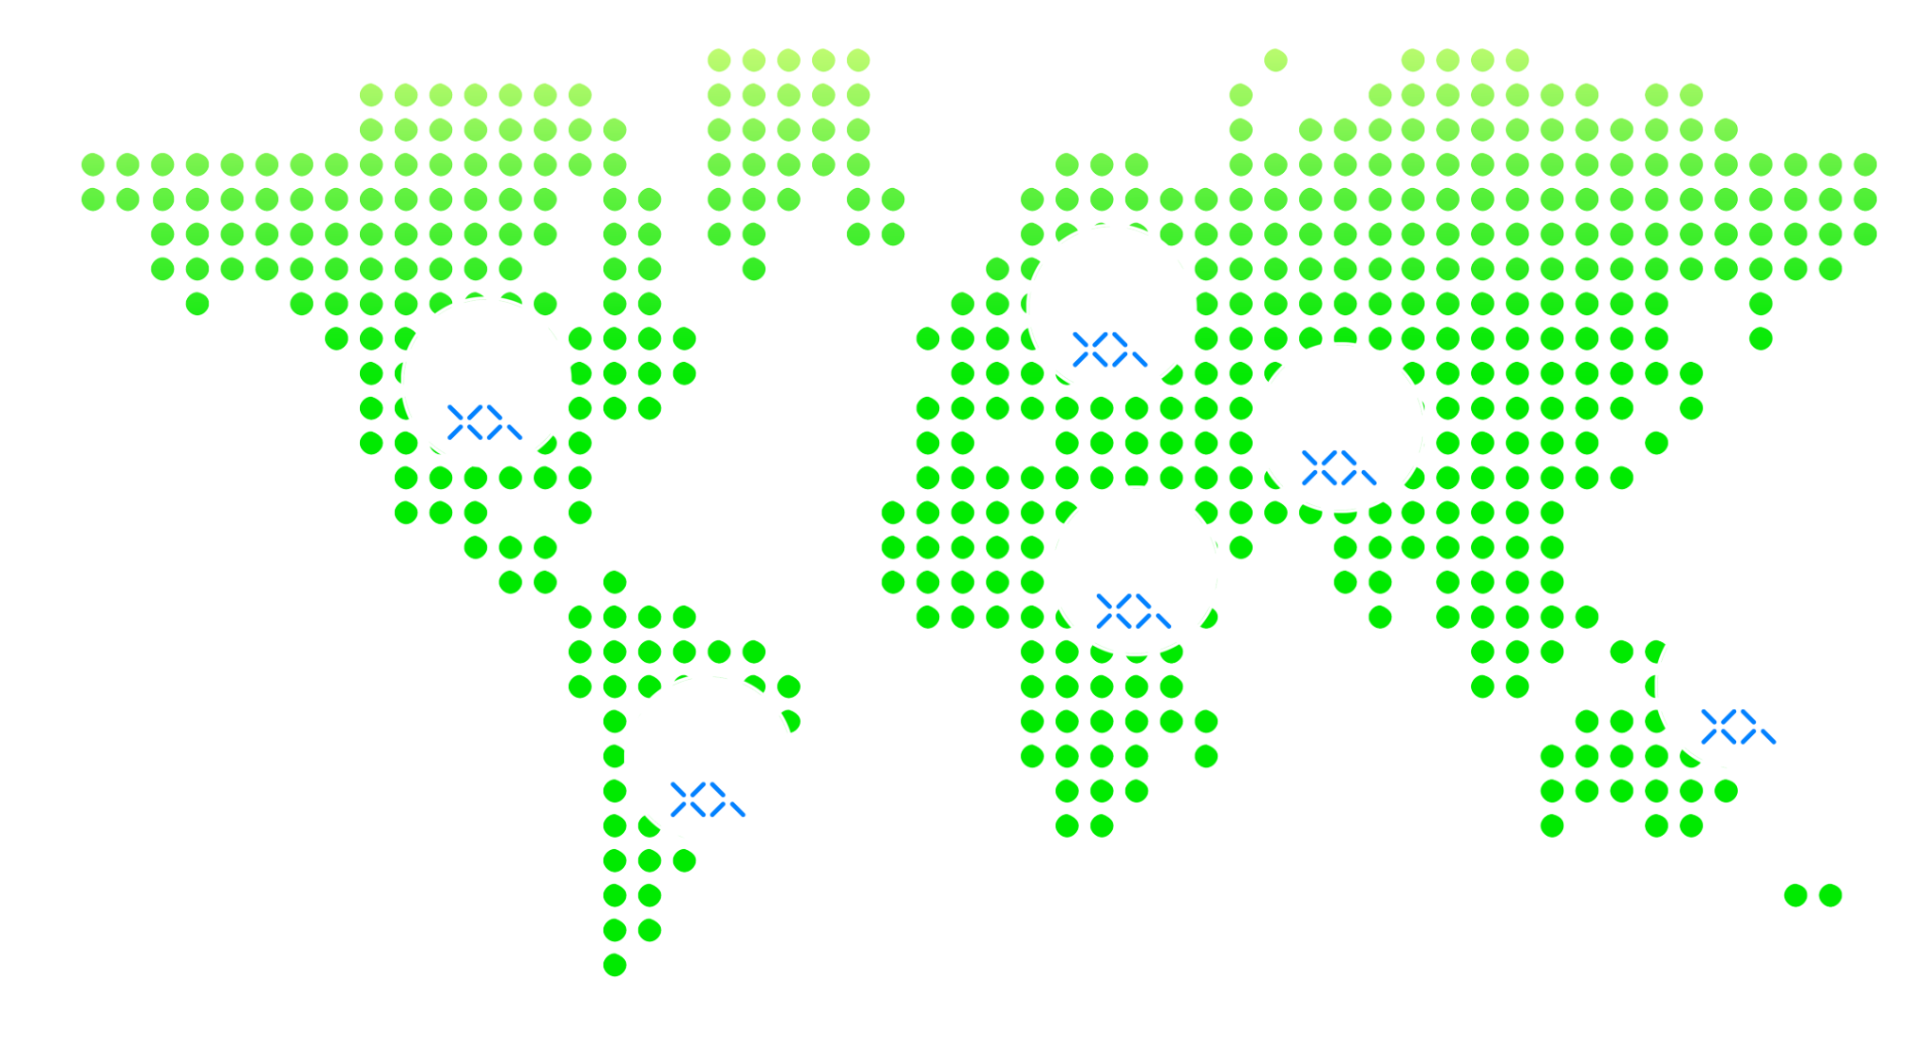
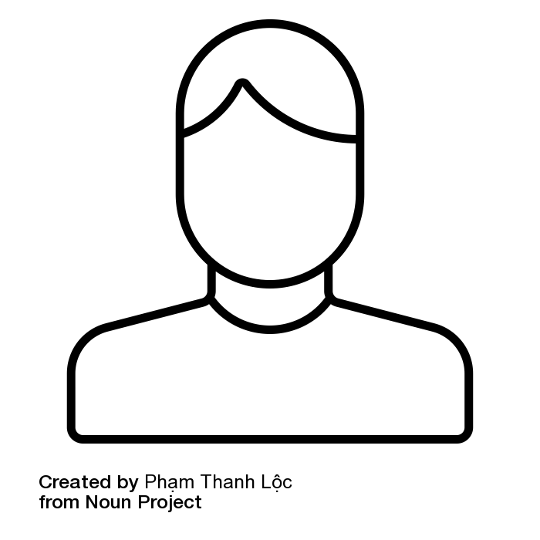
Data secure sentinel – How does it works?
Access Control
Labeling & Tagging
Loss Prevention
Compliance Monitoring
Data Secure Sentinel
Stop Data Theft, Ransomware Extortion and Access Violations
Cross Border
Your Applications
Your Environment
Your Data
Bad Actor
Ransomware
Malware
In Network Cloud Data
Out Network Edge Data
data
data
data
X
Authorized Group
Insider Threat
Automated Data Governance No Matter Where Your Data Lives
Gives you external control over every file and database record, so you never have to choose between cloud benefits and data control.
Data Secure Sentinel

Slide 56
Use cases for Zero Trust Data
Enhancing Financial Safety While Securing Critical Data
Secure Critical Communications
Enhance Customer Trust & Loyalty
Competitive Advantage
& Brand Differentiation
1
2
3
Protects sensitive communications with end-to-end encryption and access controls.
Provide clients with clear visibility into how their data is accessed, used, and protected.
Demonstrate a commitment to data privacy and security, attracting more security-conscious customers and increasing conversion rates.
Compliance Simplification
Secure Data Sharing Across Institutions
Fraud Prevention & Risk Reduction
4
5
6
Meet global financial regulations (e.g., GDPR, CCPA, PCI-DSS) with automated audit trails and transparent data governance.
Enable encrypted, policy-controlled data exchanges between banks, fintech partners, and regulators without exposing sensitive information.
Ensure real-time monitoring and control over data access to detect and prevent unauthorized financial transactions.
Qintess delivers cost effective data governance solutions and managed services for businesses of all sizes

Slide 57
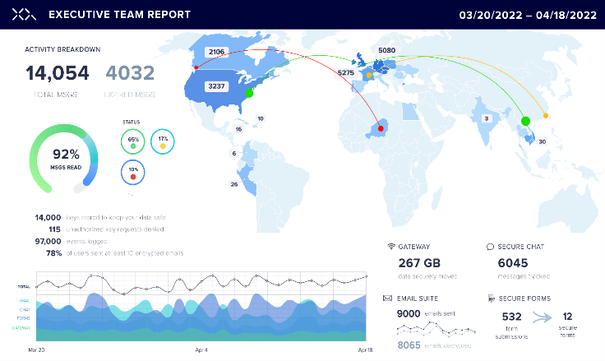
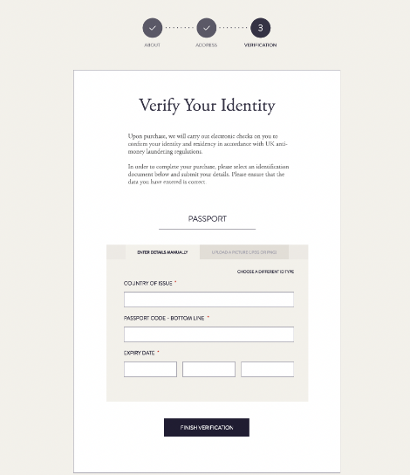
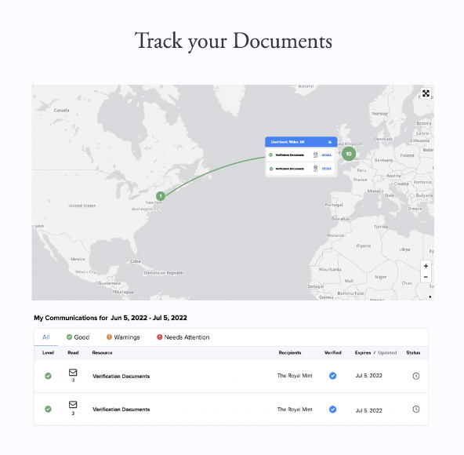

Data Sovereignty Know Your Customer validation and customer data transparency
ILLUSTRATIVE
Automated Security & Compliance Cost Optimization
Business Modernization
Ransomware Extortion Protection

Slide 58
QONFORM

Slide 59




Legal, Compliance and Risk
departments struggle with
Document Analysis and Review
Contract Generation
Create standard contracts, partner agreements and other legal documents quickly and in a personalized way.
Compare and review legal documents, identifying problematic clauses or inconsistencies.
Compliance Analysis
Risk Identification
Consistency, policies analysis, compliance with local, state and federal regulations.
Contract and agreements analysis to mitigate legal and compliance risks.
constant search for
Knowledgeable and scalable
operational efficiency

Slide 60



Adding Value with
Scalable knowledge
Time is money
Knowledge is value
Consistency is a must
Saves Time: Businesses that implement document analysis and verification that could reduce document processing time by up to 50%, leading to improved productivity.
(Source: Forrester – 2023, “Forrester’s Predictions 2024") ​
Reduces Operational Cost: Simplifying and enabling document generation with the right knowledge can save organizations between 20% to 30% in operational costs by lowering labor expenses and minimizing errors.
(Source: Gartner-2022)
Scalable and persistent: By leveraging innovative technologies and fostering a culture of continuous learning, the creation of a scalable and persistent knowledge system ensures "doing the right thing with the right knowledge". Scalable knowledge acquires significant relevance through the persistence of content, ensuring that its dissemination occurs in a solid and consistent manner (at scale).
Improves Accuracy and Reliability: Standardized document and information analysis ensures that data is interpreted consistently, mitigating the risk of errors and supported by a community of knowledge.
Streamlines Information Processing: Consistency in document analysis improves efficiency by automating data interpretation and extraction, reducing manual overload.
Supports Better Data Management: Standardized and knowledgeable analysis enables easier data categorization, retrieval, and utilization, leading to more informed business insights.

Slide 61
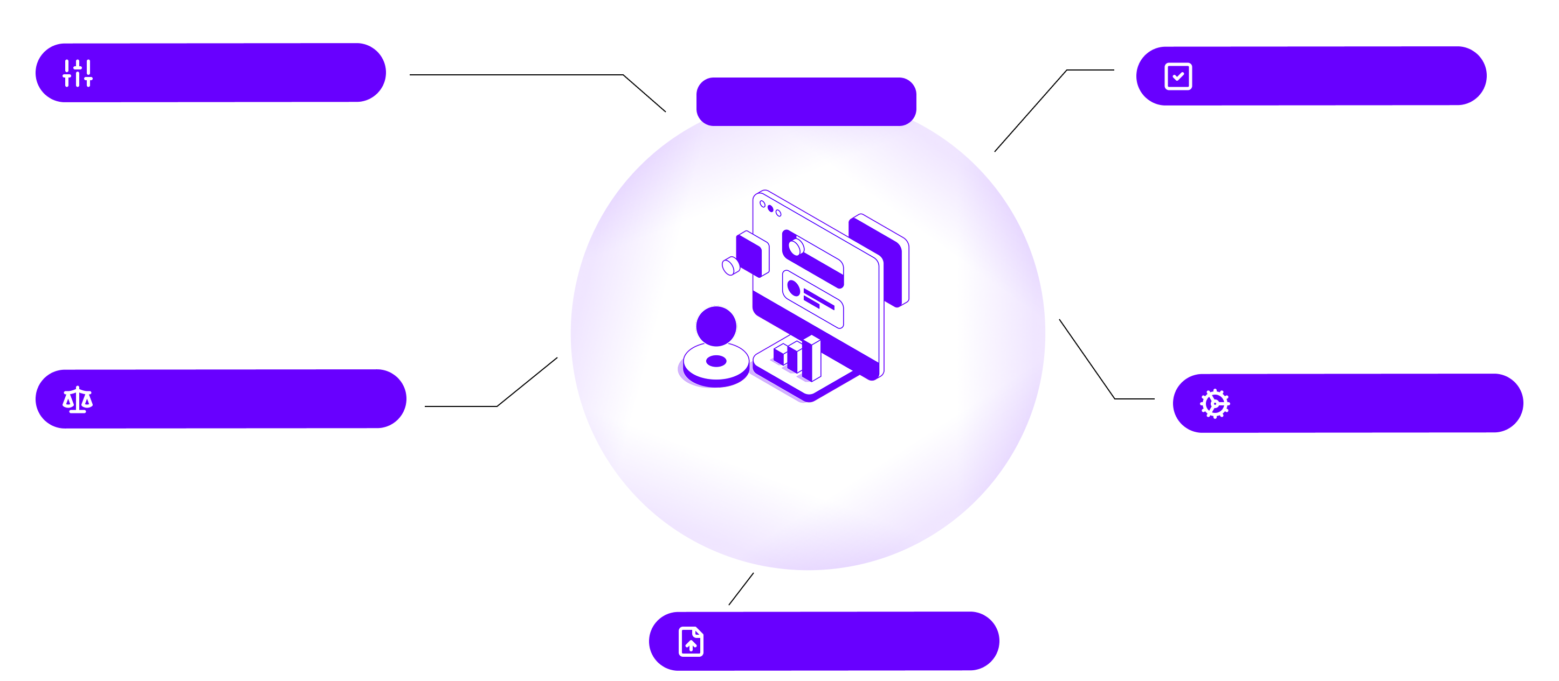
Our solution ensures a knowledge-driven operational efficiency scalable model across the organization
Consistent Answers
Policy Compliance
Scalable Knowledge
Creating consistent answers through a combination of research, clear structure, use of a knowledge base and careful review of regulations, patterns, compliance rules or any other type of standard.
Using structured knowledge that ensure compliance with the format and content, as well as keeping track on the versions and approvals of the document to ensure transparency and traceability.
Trusted Comparisons
Process Knowledge
Reliable analysis through reliable knowledgeable sources, acting as the basis of recommendations and content generation (e.g. legal decisions or legislation). ​
Knowledge-driven Operational Efficiency
Consists of creating a repository of pre-existing analyses so that the processes on legal, compliance or risks areas can be continuously improved.​
Real time Data
Connected to online sources ensuring real-time updates.

Slide 62


Work with Qonform to get the
As a knowledge platform, we focus on intellectual work, elaboration and inquire of complex documents. The system keeps all data secure, since all sources, information and results are kept inside the platform and with access permissions policies. It consists of 2 main functionalities – Knowledge center and Action triggers.
Knowledge centers (KC) are the sources from which the system will collect information. You can create numerous different knowledge groups and "feed" each of them with specific files and sources. This makes each one segmented and categorized, generating better results. Action triggers, in turn, allow the creation of "blocks" with predefined functionalities, such as checking for document's updates or compare information, which can be used individually or together to automate workflows.
​Scalable Knowledge at your disposal

Slide 63













HOW QONFORM WORKS
Scalable knowledge achieving efficiency through targeted actions
Knowledge Center
Action
triggers
Qonform in action:
It is the source of the information to be used
Can be applied to several file types, linked to drives or URLs
Unlimited number of KC’s
More than 1 can be used as a source for cross-referencing information
Can be used at different times in the detailed sequence of activities where Action Triggers will be activated
Choose an activity based on the action triggers and define from which and how many Knowledge Centers the information will be collected. Simple as that!
Will be defined in the local language and the same way as a human thinks.
Can be used individually or in sequence for more complex activities.
Unlimited number can be created and used
Feed your Knowledge centers:
You can maintain your knowledge centers updated using files or existent content in sources you trust as:
Private files from your computer or local organization shared folders
Internet drives
URLs
APIs

Slide 64








A deeper understanding
Understand the potential for improvement between activities and processes to make performance more agile and scalable
Qonform can be integrated in existing processes or used as a single platform.
Single usage:
Composite usage:
One Action trigger connected to one Knowledge Center
Action Triggers activity flow created using more than one knowledge centers (shared or private)
Inputs
Platform
Outputs
API with result
Integration layer
API to
Start the flow
API to feed Knowledge Centers
API
with result
Private Knowledge Center
Shared Knowledge Center
Action triggers

Slide 65


Qonform applied to
Legal, Risk and Compliance
Expected results:
Action triggers:
Extract key clauses from NDA ​​
Analyze supplier proposals based on predefined criteria and existent knowledge
Review documents to be signed based on previous requested amendments
Due diligence support
Create and checked compliance with ISO standards, making processes more efficient, accurate and up-to-date
Policies draft generation and validating that must adhere to company standards
“When the NDA with a company is ending?”
“Analyze the 5 different proposals for project management solutions focusing on cost, quality, and delivery timelines.”
“Summarize the concerns from the analysts and locate policies or standards that are related with those topics.”
“Generate draft engagement policies based on existing standards and knowledge. Check that the requisition adheres to the policy and display the items that do or do not adhere using a traffic light. “
“Based on existing standards and knowledge. Check that the document complies with ISO 27.000 and display the items that do or do not comply using a traffic light. ”

Slide 66
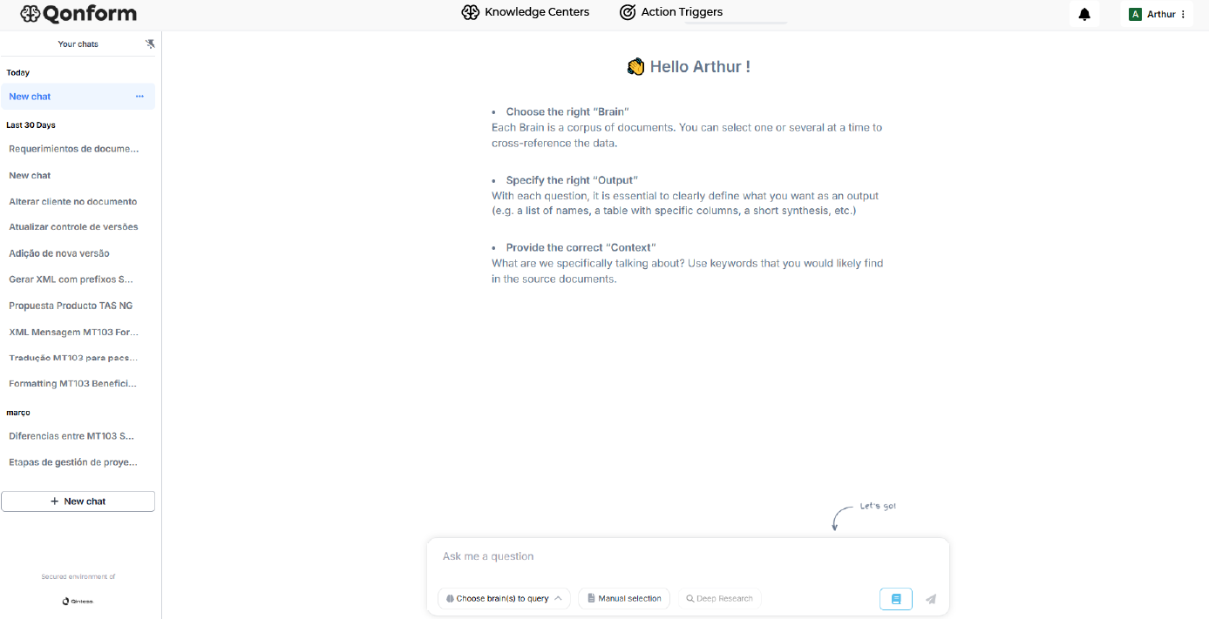
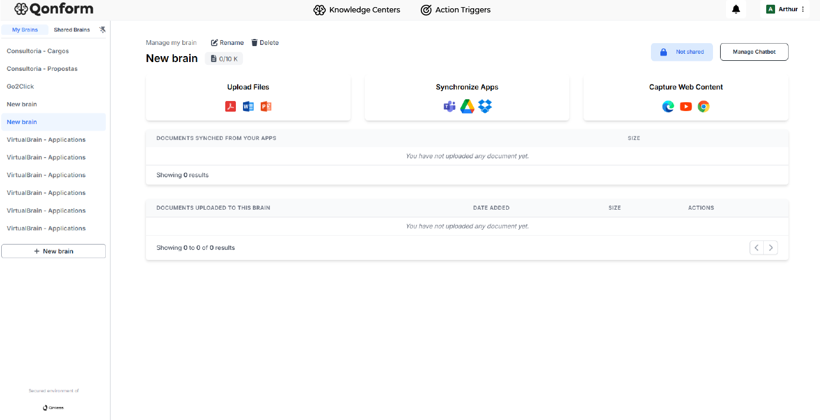
Use Case: Optimizing Contract Analysis
Context
The Facilities team struggled to interpret and compare information in complex and inconsistent contracts, making it hard to identify coverage, terms, and agreed amounts. This scenario required thorough document analysis, making the process time-consuming and prone to manual errors.
Solution
To address the issue, after speaking with the knowledge experts that understand their daily activities in detail, a Knowledge Center was created on the platform to store contracts and action triggers defined, aiming to automatically extract key contract terms, identify validity and coverage values, compare coverage percentages across contracts, and organize the information clearly, reducing the need for manual searches.
Results
After implementation, the team received a structured preliminary result, easing contract understanding without full manual reading. Facilities professionals were satisfied with the data accuracy, noting benefits like reduced analysis time, greater assertiveness in contract comparisons, and more agile decision-making with organized data.

Slide 67
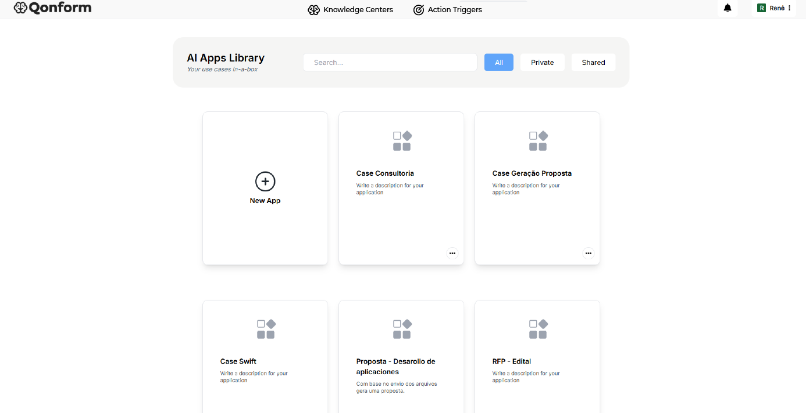
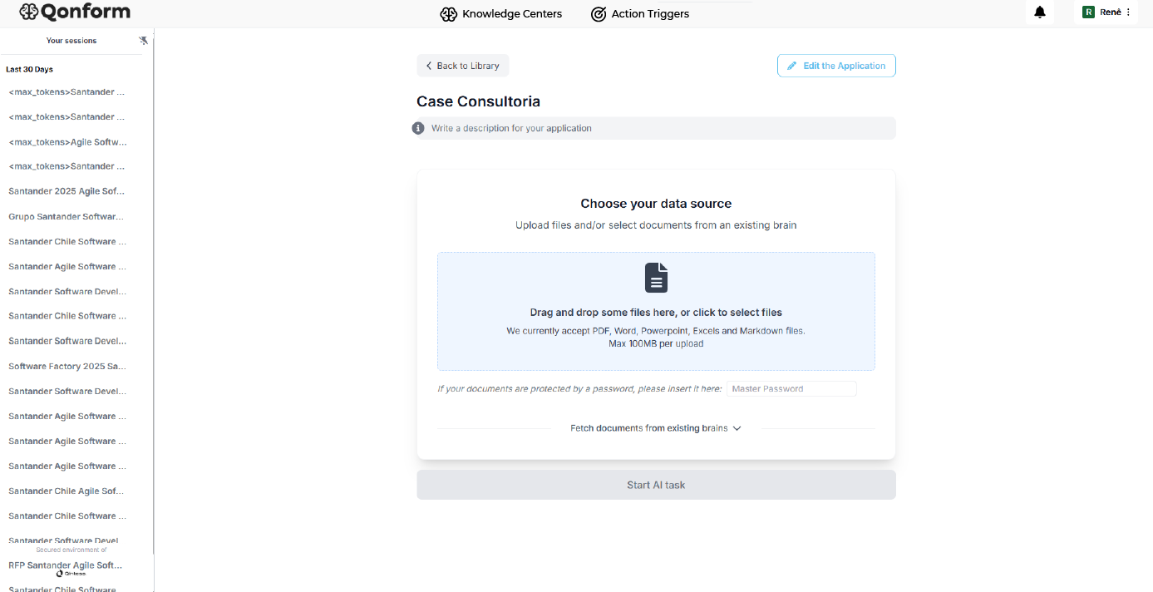
Use Case: Insurance policies compliance
Context
The compliance team handles a substantial daily volume of intricate contracts that necessitate evaluation of insurance coverage policies. This situation demands a comprehensive analysis of the documents, resulting in an initial process duration of five days and a susceptibility to manual errors.
Solution
We organize the flow thought Discovery and after this the creation of a Knowledge Center on the platform to store internal policies and regulations, as well as the use of action triggers, aimed to extract the main rules and policies from reports, identify coverage clauses and adherence to policies, compare coverage percentages between contracts and organize information clearly, reducing the need for manual checks.
Results
After implementation, our team delivered a streamlined preliminary result that simplifies contract comprehension, eliminating the need for manual review. Professionals appreciated the ability to quickly process large volumes of data, easily spotting inconsistencies and non-conformities that would have otherwise gone unnoticed. This shift allows them to focus on evolving processes rather than just conducting compliance checks.

Slide 68
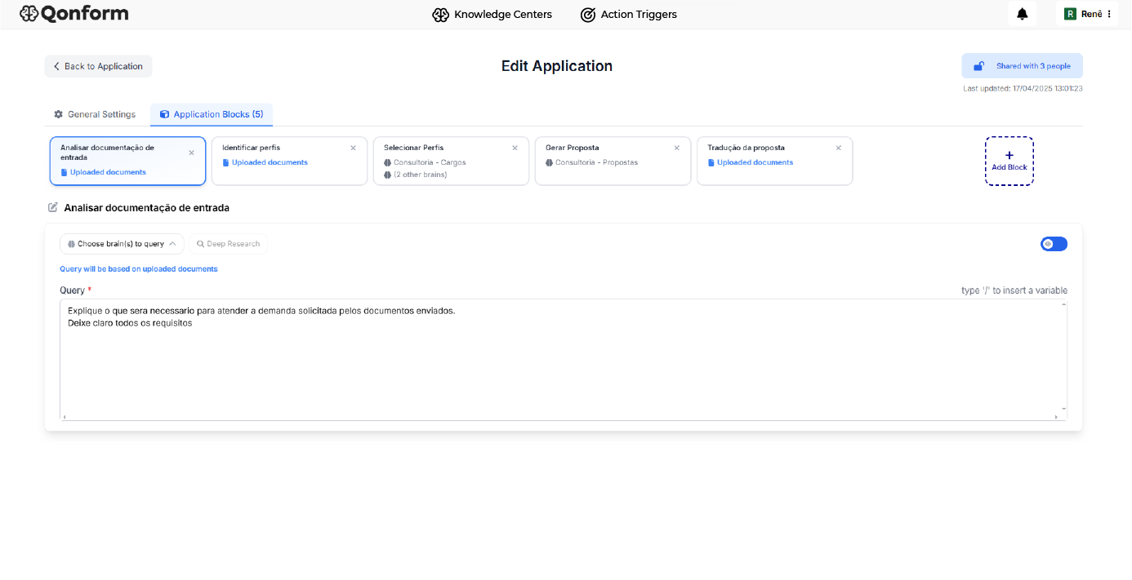
Use Case: Payment's knowledge support( compliance with ISO 20020)
Context
The product team has a large daily volume of messages in which it needs to evaluate and understand the transformation rules. This scenario required a thorough analysis of a large volume of documents and compliance with law, which made the process hard to interpret.
Solution
The creation of a Knowledge Center on the platform to store the business rules and transformation criteria for the new established standard, as well as the use of action triggers, aimed to extract the main rules and adherence to the transformation.
Results
After implementation, the team received a structured preliminary result, making it easier to understand the transformations and check the ISSUES without having to read it manually. The professionals were happy to analyze quickly, identifying inconsistencies and finding information that was not consistent, reducing their analysis efforts and the time it took to submit the messages.

Slide 69
INNOVATION & DIGITAL ENABLEMENT

Slide 70










Innovation programs To assess the maturity level of Innovation and its contribution to the company, we apply our proprietary AI model, enabling us to propose tools and various approaches to achieve your objectives with maximum impact to the business.
Programs
R&D&I
Trends
Ignite
In-Culture
Startup ecosystem challenges
Qintess innovative ecosystem maintain a portfolio of programs running in a modularized way, making it possible to design the best innovation journey adapting to your business.
Hackat-Up
Portfolio Diversification
Knowledge Center
Idea
Colab thinker
Innovation Maturity index
Think Faster

Slide 71




IQ Framework adopts
Innovation Awareness
Innovation Programs
Innovation Culture
Running in an ecosystem for diverse experiences
Partnering with Innovation
Once aware, Qintess AI solution generates the 'Innovation maturity scan' and already recommends programs that will provide a better journey towards innovation.
AI
Assessment
Technical Axle
Cultural Axle
Programs selection
Innovation Discovery
Once implemented, we help you measure and maintain engagement for a innovation culture.
Easy of mapping the maturity level, by both options of Qintess Discovery process
Business units
Periodically update and adopt new challenges
Innovation
Analytics & Data Science
Architecture
Digital infrastructure
Design

Slide 72
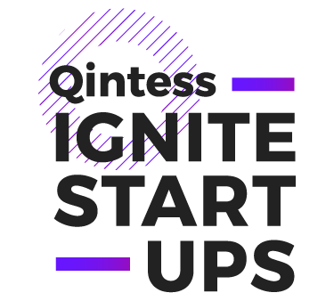
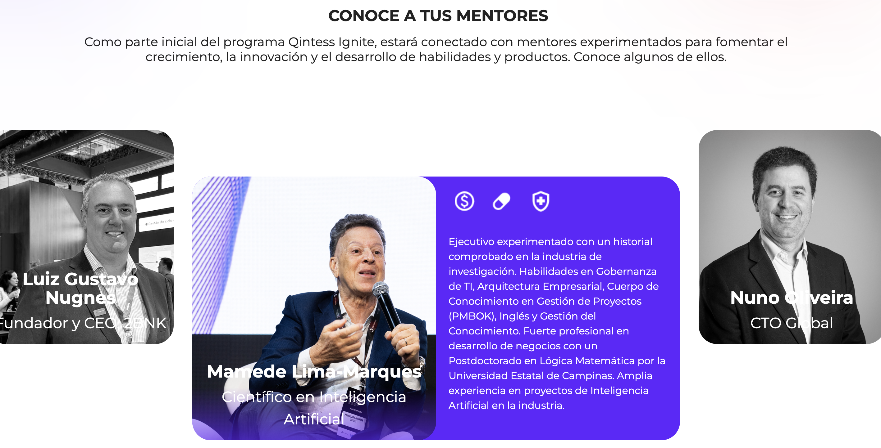
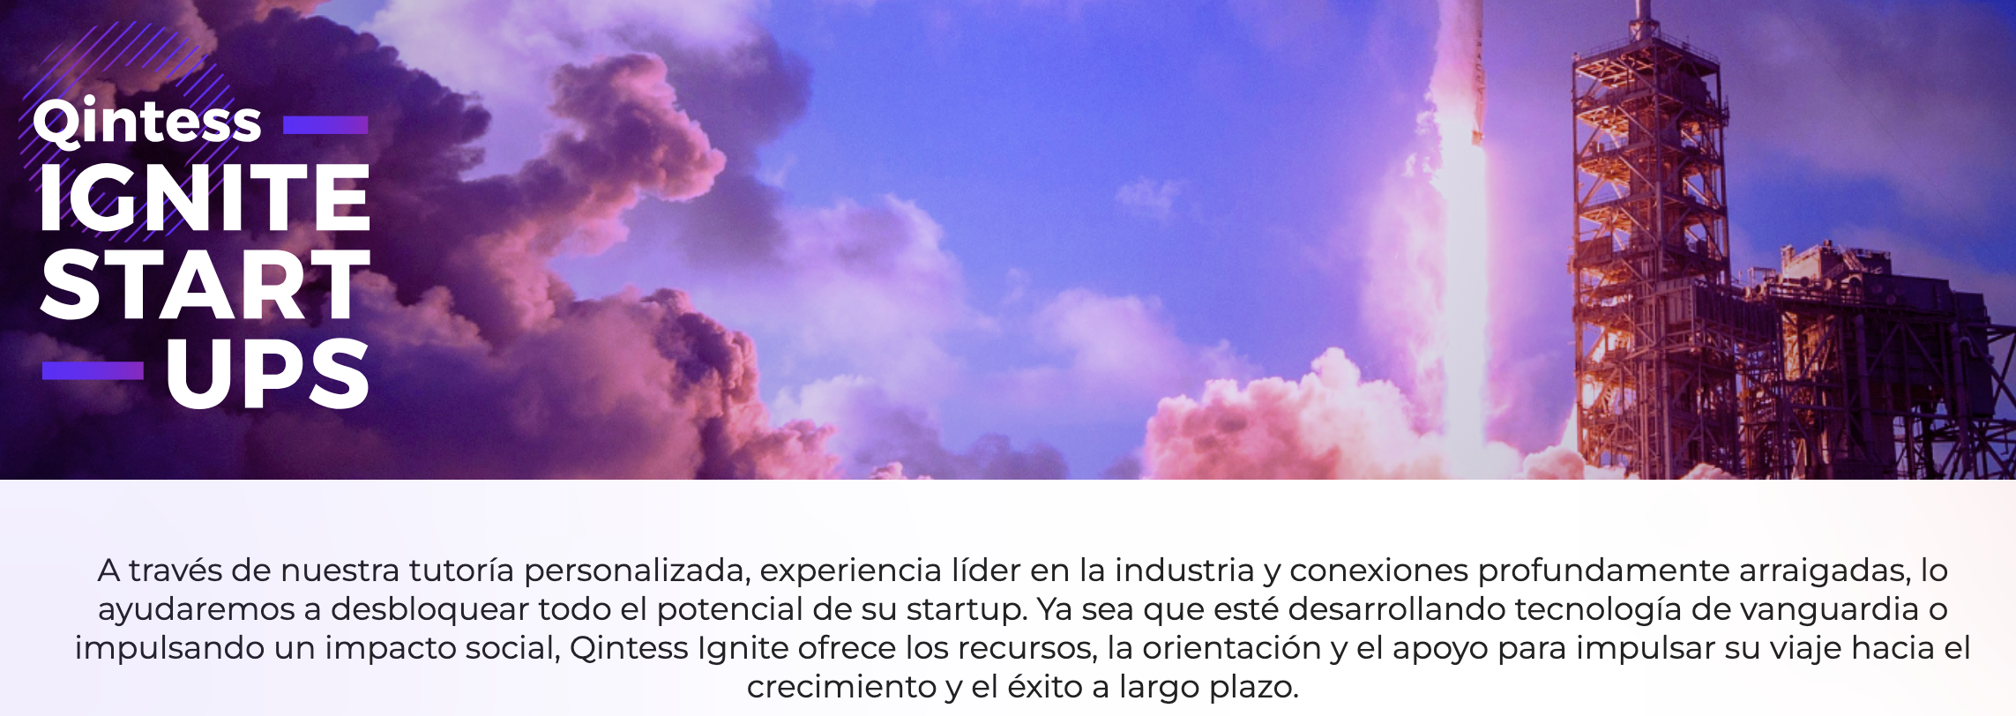
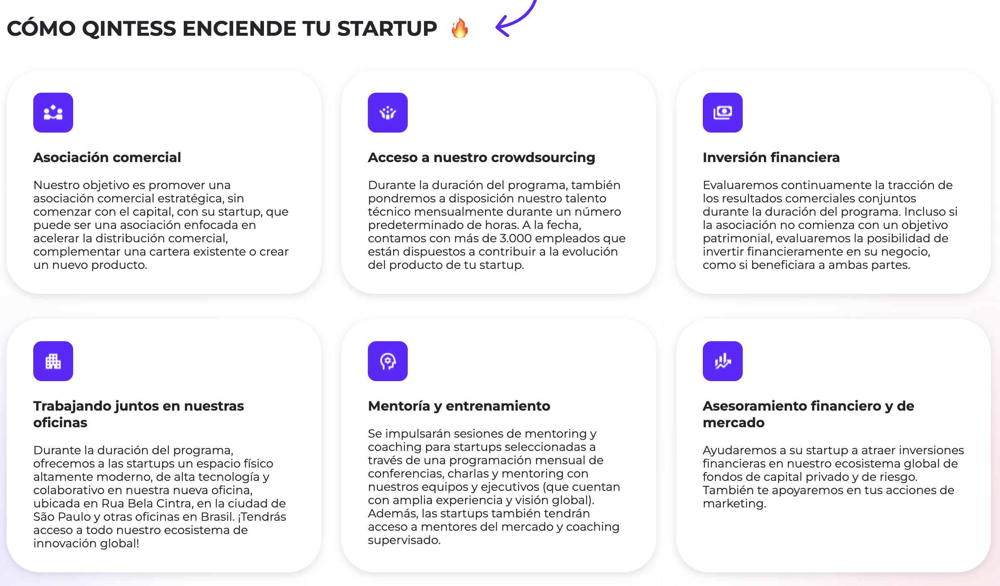
Third Edition

Slide 73
QINTESS SYSTEM MODERNIZATION

Slide 74
Overcoming Digital Transformation Challenges
Digital Transformation is the process of replacing traditional and legacy systems models with digital alternatives that improve performance, response time to market changes and user experience. It's a journey that goes through various aspects of the business and not just technology.
THE PROBLEMS WE SOLVE
It is not possible to change what you do not know.
Documenting legacy systems manually is not feasible
Business knowledge is in the legacy system
No current scenario, no safe journey
Legacy systems took years to be developed or customized and their documentation, throughout their life cycle, is not properly updated.
Without deep and detailed knowledge, it is not possible to start a modernization process.
Manually documenting legacy systems, seeking to understand the system architecture, data, APIs, business rules and other components is not feasible and will take up precious time in the transformation journey.
Most business rules are within the legacy system and not properly documented in a standardized way outside the code. It is common that the functionality history has been lost over time, that is, only the legacy system keeps the information of what is being done.
It is not possible to define a safe, gradual and agile digital transformation journey without understanding the legacy architecture, how it uses the digital mesh, what business problems are solved and how.

Slide 75
What we do
1 - Definição clara dos objetivos da Transformação Digital.
2 - Inventory and documentation of legacy systems base to be modernized.
3 - Automatic generation through AI of complete documentation of legacy systems and business processes involved.
4 - Definition of the modernization strategy to be adopted and definition of the modernization architecture.
5 - Delivery of the Qintess System Modernization journey with AI/ML platform
6 - Activation of the Support Service from the first delivery.
1 – Digital transformation clear objective definition.
QINTESS SYSTEMS MODERNIZATION
6 - Activation of the Support Service from the first delivery.
2 – Inventory and documentation of legacy systems base to be modernized.
It is an innovative and unprecedented approach developed together with Platform that allows the creation of an integrated, gradual and agile Digital Transformation journey through the understanding of the current moment, the modernization of the digital fabric and the digitization of business processes.
QINTESS AGILE
PLATFORM & ENGINE
5 – Delivery of the Qintess System Modernization journey with AI/ML platform.
3 – Automatic generation through AI of complete documentation of legacy systems and business processes involved.
4 – Definition of the modernization strategy to be adopted and definition of the modernization architecture.

Slide 76

How we do​
DIGITAL TRANSFORMATION JOURNEY
Definition of the strategy to be used for the modernization
Definition of the architecture for the modernization of legacy systems
Definition of the architecture of the digital mesh infrastructure
Creation of technical and functional skills
Creation of multidisciplinary squads
Delivery through agile methodology
Support deployment of the transformation environment
Delivery of the modernized and transformed legacy system.
LEGACY SYSTEMS SOURCE CODE SCAN
Recognition standard
Exclusion pattern
Parameterization
Symbol table
KNOWLEDGE BASE and AI
Inventory/Mapping
Automatic code migration
Identification of databases
Relationship systems/objects
Systems/database relationship
Relocation of sensitive data
MAPPED LEGACY SOURCES
Applications knowledge
Interfacing with partners
APIs (cloud)
Export/Import Data
PLATFORM & ENGINE
QINTESS QSTUDIO JOURNEY DELIVERY
QINTESS SYSTEMS MODERNIZATION

Slide 77


OUR CLIENTS
To whom we serve!
Throughout our history, we have had the privilege of participating in the business transformation processes of hundreds of companies, accelerating their digital transformation journey and delivering concrete and sustainable results.
77

Slide 78


Contact Us
Nuno Oliveira
Global CTO, Vice President
nuno.oliveira@qintess.com

Slide 79

We are
Qintess!

Slide 80
Appendix

Slide 81



















Business Driven Architecture IT AS A BUSINESS PARTNER – DELIVERABLES EXAMPLES
ILLUSTRATIVE
Area Vision / Strategic drivers
Capabilities Mapping
Prioritization, Roadmap & Initiatives
ROADMAP: AS IS / TO BE Systems
“Pain points”
BOM playbook
ALIGN IT WITH BUSINESS TO BECOME A PROACTIVE PARTNER

Slide 82














Business Driven Architecture IMPROVE IT EFFECTIVENESS – DELIVERABLES EXAMPLES
ILLUSTRATIVE
Enterprise Architecture Governance
Setup and Run new models
Key IT Processes
Delivery Optimization Model – CoE’s
ENSURE MAXIMUM OPEX, PEX AND CAPEX EFFICIENCY AND SERVICE LEVELS

Slide 83











Business Driven Architecture TECHNOLOGY AS A COMPETITIVE ADVANTAGE – DELIVERABLES EXAMPLES
ILLUSTRATIVE
Architecture Reference models
Application / Platform Inventory
Domain mapping and categorization / Business Alignment
Business Value vs Application Quality
From Value Preservation to Value Creation
LEVERAGING MARKET TRENDS AND SOLUTIONS

Slide 84













Business Driven Architecture ARCHITECTURE ADVISORY SERVICES – DELIVERABLES EXAMPLES
ILLUSTRATIVE
Corporate Strategy leveraging Technology
New Business Models
RECOMMEND ARCHITECTURE PATHS, DO’S AND DON’TS BASED ON EXECUTIVE EXPERIENCES

Slide 85







Business Driven Architecture PROTECT ORGANIZATION ASSETS – DELIVERABLES EXAMPLES
ILLUSTRATIVE
Cybersecurity Strategy and Enablement
FOCUS ON SECURITY STRATEGY AND MAJOR IMPACTING INITIATIVES

Slide 86
























BOOSTERS – TOOLS AND ARTIFACTS
Landscape Overview
Business Process Capability Map
Application to process capture
Management dashboard
Current-State Assessment
Migration Destiny Analysis
Business Growth Heat Map
Risk Analysis DR & Backup Capabilities
Risk Mitigation strategy
Cost Reduction Strategy
Logical to physical application mapping
Candidate opportunity prioritization
Technology Portfolio Profiling
Technology Stack Assessment
Transformation Initiatives
To-Be Application Landscape
Proposed Future State- BI
Transformation RoadMap
Application transition map
Project dashboard
Application Inventory
Technology stack
Migration Complexity Assessment
Application Migration Analysis

Slide 87
Data Access Control - Differentiation
Cost Benefit | Value Prop | Replaces | Replaces Take Away
3 to 8x cost savings | Automated Data Level Security Plug and play encryption as a service Separates security from the environment for each data object with automated external key store. Automation of external secrets management and rotation Automated role-based access management at the data level Data object chain of custody for compliance beyond environment boundaries. Massive cost savings with layer on security insurance | Hashicorp Skyflow Fortanix aKeyless CyberArk BeyondTrust Thales | Automates security, access, and compliance management. Services offer localized encryption as a manual request, tied to the environment. Security and compliance do not extend beyond a single environment. Secrets are not automatically rotated per data record, leading to increased overhead. Lack of a secure chain of custody for compliance necessitates additional access management and logging layers. Role-based data security access is limited to applications and networks, not bound to the data.
 |  |  | Example: akeyless makes a copy of your keys and stores the keys for your data in the cloud, thus enabling data exfiltration

Slide 88
Data Access Control - Differentiation
Data Access Control - Differentiation
Cost Benefit | Value Prop | Replaces | Replaces Take Away
2 x cost savings | XQ integrates encryption, DLP, and Data Access Control directly to data for streamlined security. Enables immediate identification and real-time mitigation of breaches. Implements DLP policies at the granularity of individual data objects with dynamic access adjustments. Oversees DLP across all platforms, guarding against data exfiltration, ransomware double extortion, and insider threats. Provides comprehensive protection by addressing threats posed by network administrators and similar entities. | WIZ Zscalar Digital Guardian DLP platform/ Fortra Symantec Data Loss Prevention Forcepoint DLP Trelix DLP Capture Trellix Data Loss Prevention (DLP) Endpoint | Ensures every data packet is uniquely encrypted from the edge, preventing lateral movement in case of a breach. The competition DLP scans existing environments for breaches, while the solution enables DLP policies across all environments. Allows data revocation at any time, georestriction, and time-restricted DLP policies at the data object level. Logs data access across the digital estate, providing forensic-level audit logs and real-time breach notifications. Forcepoint DLP classifies data and restricts access but lacks individual per-file encryption, cross-platform security, and data revocation ability.
 |  |  | Example: Forcepoint does not protect cloud data from network admins, insider threats, aging credentials, or geolocation-based access restrictions.

Slide 89
Low code
It can help you boost your development
Criteria
Low Code
Traditional Development
Responsibility
IT developers and citizen developers​ ​
Specialized IT developers
Time to launch​
1 to 4 weeks thanks to drag and drop editors, Ci/CD (continuous integration/continuous delivery), Cloud Native
4 to 6 months of development, Ci/CD creation, Cloud configuration and implementation
Costs​
Most low-code platforms work on a subscription basis, allowing you to pay as your business grows. It also makes reduction easier.
You need upfront investment for an experienced development team, infrastructure setup, and ongoing management.
You can reuse different resources and code blocks from one low-code application to another for rapid development.
.
While it's not impossible to reuse code from one high-code application to another, it would require a lot of tweaking and maneuvering - all of which can be a time-consuming process
​
Reusability
Scalability
Highly scalable depending on demand
​
Need to plan and build according to scale
Security
Dedicated support team provided by the low-code platform.
.​
Your internal IT team will be responsible for providing support and managing the application

